Slide 1

An Engineer’s Critique of Global Warming ‘Science’
Questioning the CAGW* theory
* Catastrophic Anthropogenic Global Warming (global climate destruction caused by human emissions of greenhouse gasses)
By Burt Rutan
Version 4.3, Jan 2011
This presentation can be downloaded at http://rps3.com/
Or, Google “burt rutan climate change”
Notes:
You will see a look at this debate like no other. I will show not just the warning charts used by the media and the magazines, but a bunch of new presentations, arranged to Inform you, not to Scare you.

Slide 2

Our CO2-starved Atmosphere
Note, the green life along the Nile river and the dead desert elsewhere. When co2 is greater in the atmosphere, plants need less water to thrive.
When dinosaurs roamed we had 3 to 5 times current co2 and planet was nearly all green, pole-to-pole
Near catastrophe when co2 declined to 180 ppm, since below 150 ppm plants, then animals die.
If you promote a green healthy planet, then you should lobby for a co2-fertilized atmosphere, not a co2-starved atmosphere.

Slide 3
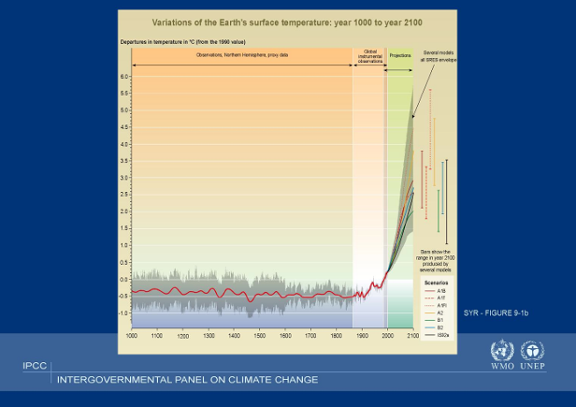
My Introduction to the Global Warming Scare
United Nations Intergovernmental Panel on Climate Change
This chart includes a large number of next-century predictions - all of them showing either big problems or catastrophe in the next century; all caused by a theory of CO2 greenhouse gas heating from human emissions (AGW).
Is there something an engineer can do to solve this problem?
Red Circle is the claimed CAGW scare

Slide 4
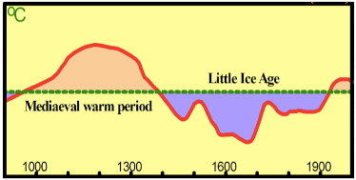
What Happened between 1990 and 2001?
IPCC
2001 report
The ‘hockey stick’ data presentation shown here is no longer used, even by the UN, since it has been shown to be fraudulent.
Red Circle is the claimed AGW scare
Players in the CAGW issue:
Government Scientists, Universities, Politicians, Top Leadership, Science Media, etc.
But…. No engineers or engineering studies/programs are being evaluated for the IPCC Reports.
IPCC 1990 report
Current temperature

Slide 5
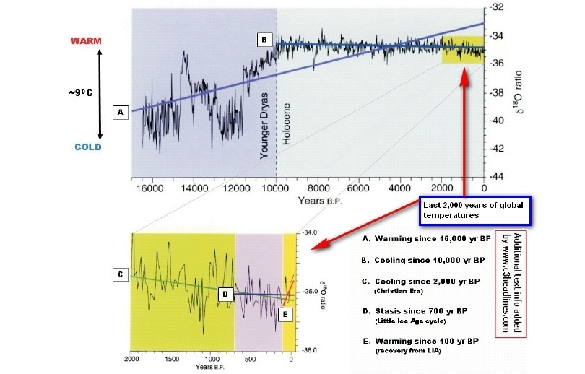
The significance of “Statistical Significance”.
This Chart shows five “trends”, all ending at CY 2000:
A - 16,000 years, includes recovery from ice age.
B - 10,000 years, the current “stable warm period”.
C - 2,000 years, the Christian Era.
D - 700 years, the Little Ice Age (LIA) cycle.
E - 100 years, recovery from LIA.
All 5 trends except E are Statistical Significant. However, trend E is what the Alarmists focus on, to ‘prove’ the correlation with human emissions.
Data from GISP2 ice cores (after NSIDC User Services 1997 and Davis/Bohling, 2001.

Slide 6
An Engineering look at Man-Caused Global Warming
Not a Climatologist’s analysis - a view from a flight test engineer who has spent 45 years doing data analysis/interpretation/presentation.
A focus on how the scientific community has handled the ‘global warming due to fossil fuel burning’ theory.
A review of the climate data, then a study on how the results are selected, presented and promoted.
The focus is on an Engineering Approach – where data are critical and there are consequences for being wrong; not the Scientist approach – where a theory is the product and it can be right or wrong without repercussions.
A presentation of climate data the way an engineer would show it – present all the data, then do analysis without bias to any proposed theory.
Notes:
6
Engineering decisions and conclusions have real consequences; in my work they can cause bankruptcies, as well as kill pilots and passengers. Thus, engineers' focus must be precise, conservative and as confident as possible. Scientists however are allowed to stick their neck out with far-out theories, and in many cases theories that cannot be proven. When they are shown to be wrong they can and do just move on to another theory without consequences, even from their peers. My lifetime work from childhood to the present has been focused on aircraft/spacecraft design and development, with flight-testing being my career specialty. Thus, I have always been challenged to determine the accuracy and meaning of a large amount of disparate data and have often been required to apply those interpretations to development of a product that absolutely must be safe and robust.
Why did I study? An observation that there is something seriously wrong with this picture. When I graduated from College few were willing to take the many job offers in the Los Angeles area due to smog - it literally hurt your eyes to be outside much of the time. Now it is very clean, with 4 to 5 times the cars. Technology solved that horrific problem; could we really be facing a legitimate crisis now??
My interest is because I found the real picture is opposite of what you see on the Media. I found enormous fraud in how the data was being presented and have spent several years studying the issue. This presentation summarizes what I have found.
My study is NOT as a climatologist, but from a completely different perspective in which I am an expert.
Complex data from disparate sources can be processed and presented in very different ways, and to “prove” many different theories.
For decades, as a professional experimental test engineer, I have analyzed experimental data and watched others massage and present data. I became a cynic; My conclusion - “if someone is aggressively selling a technical product with merits dependent on complex experimental data, he is likely lying”. That is true whether the product is an airplane or a Carbon Credit.
6

Slide 7
Modern Human-Extinction Scares
Population Bomb, starvation/crowding - 1940s to 1970s
Silent Spring, DDT - 1960s & 1970s (outlawing DDT killed millions)
Global Nuclear War - 1950s thru 1980s
Global cooling, Ice Age/starvation - 1956 to 1977
Hole in the Ozone layer, caused by CFCs, 1970s & 1980s (We now know that the Ozone changes were not caused by human CFCs)
Nuclear Winter, nuke-caused ice Age - 1980s & 1990s
Asteroid Impact - 1930 to present (a real, but remote risk)
Global Warming - 1929 to 1969 and 1987 to 2003
“Climate Change” - 2003 to present
Is ‘Climate Change’ just another over-blown scare?
Notes:
7
Since childhood I have always been fascinated by the media coverage of the Big Scares. Lately I have noticed that the big coverage and big focus seems to be only on those that can be blamed on us Humans.
Paul Ehrlich's "The Population Bomb" (1968), which warned: "In the 1970s, the world will undergo famine — hundreds of millions of people are going to starve to death in spite of any crash programs embarked on now.”
His co-author was our new science Czar, John Holdren; Holdren calculated in 1980 that famines due to climate change could leave a billion people dead by 2020. He championed "population control measures," and believed 280 million Americans would likely be "too many.”
Like Ehrlich, Holdren forgot that with bodies come minds, minds that can innovate, invent, find ways to farm energy, find substitutes for scarce resources and find new ways to feed people. The next scare seems to be running out of water, a silly scare when you look at a photo of our planet.
The DDT ban has resulted in the deaths of 10s of millions of people worldwide. It is only now being reversed in Africa.
The Ozone Hole scare ruined the CFC industries, killed America’s SST and resulted in inferior refrigeration. But we now know that the molecular transition requires a temperature 100 deg higher than found in the upper atmosphere. And we now know there was extensive science fraud in the Ozone Hole Debacle. Alas, the Ozone hole does fluctuate; It always has and it has nothing to do with Air conditioning or hairspray cans. But, likely you were not told that Good News on the World News Tonight. In fact, if it means admitting that they were wrong about scaring you, we seem to never find out.
The last one; getting hit with very-fast Big Rocks, is the only real threat to make us extinct.
7

Slide 8
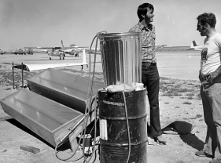
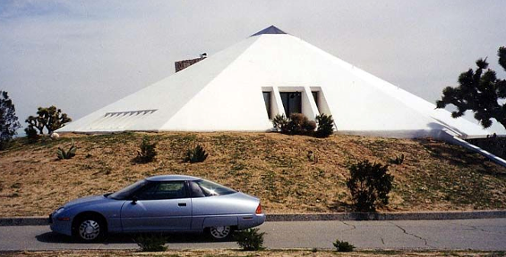
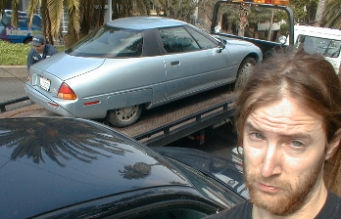
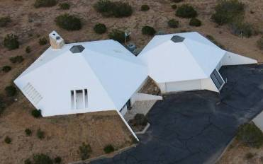

Rutan Background Includes Energy Efficiency
Solar Hot Water in the 70s.
Now building a 34-acre PV solar energy farm.
My Desert Pyramid House
“Ultimate energy-efficient house” (Pop Sci Nov 1989)
Primary car was zero-emissions EV-1, 1997 to 2004.
Loss of my EV-1 Electric car in 2004.
General Motors crushed them all
Notes:
My Interest in efficient energy design started in College in the early 60s.
My house was the Nov 1989 Popular Science Cover story; “World’s Most Efficient House”. Its big advantage is in the desert summer. It is all-electric and it uses more energy in the relatively mild winters than in the harsh summers – just the opposite of my neighbors. It’s passive energy savings comes from super insulation, earth berms on most exterior walls and massive interior thermal mass. Its passive interior temperature, in the absence of any active cooling energy runs at 82 degrees in the desert’s 117-deg F summer peak heat days. Passive interior temps are the triple average of soil temp, day air tem and night air temp. and vary only 3.5 degrees day/night, while outside air varies 35 deg F. The property has provisions for converting to self-sustaining (house and plug-in hybrid car) via adding wind generator and solar panels when it becomes cost effective to do so.
Testing Solar Water Heat in the 70s at RAF; the Rutan Aircraft Factory was converted to solar-heated water in the 70s, when others were only focused on gasoline costs.
My all electric EV-1 was best car I ever owned. It was my primary car for 7 years; all-electric with an 85 mile range on lead-acid batteries. I was very sad (just like the guy shown) when the leased cars were recalled and crushed by General Motors. I will buy a real hybrid when one becomes available (plug-in with elect-range>60 miles). The Prius “hybrid” is not a hybrid, since it is fueled only by gasoline. A Plug-in Hybrid can be fueled with both gas and electricity. You might even see a ‘plug-in hybrid airplane’ in my future.
My main interest in energy efficiency started in the 1970’s, when my desert backyard view became cluttered with thousands of large commercial wind generators, whose development was driven by the tax incentives from the oil shortage and peak-oil scare of that era. I equipped my small business with my own design, passive solar water heat system. I designed and built my custom bermed-Pyramid home, which was featured on the cover of the November 1989 issue of Popular Science magazine, labeled “The Ultimate Energy-Efficient House”. I drove the all-electric EV-1 car as my primary automobile for seven years until GM canceled the lease and took it back.
8

Slide 9
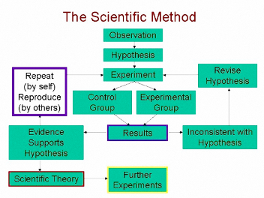
The Difference
The Engineer vs. the Scientist
Engineering Organization
  Development of a product, usually under strict certification rules.
  Responsible for the product’s worth and safety.
  Selling the product’s adequacy to Management
  Consequences if wrong (people die).
Scientific Method
  Origin of new Theories (hypothesis).
  Strict process (The Scientific Method) to gain (or lose) confidence in the Theory.
  Not responsible for adequacy or value of product.
  Frequently being wrong is not a problem.
Notes:
Engineering decisions and conclusions have real consequences; in my work they can cause bankruptcies, as well as kill pilots and passengers. Thus, engineers' focus must be precise, conservative and as confident as possible. Scientists, however are allowed to stick their neck out with far-out theories, and in many cases theories that cannot be proven. When they are shown to be wrong they can and do just move on to another theory without consequences, even from their peers. That is why the engineers, not the scientists should report to the U N, the Obama's, the Gordon Browns and the lawmakers of the world. Many more lives are at risk than those who risk airliner accidents. Imagine certifying airliners based on the kind of science method being practiced by the climate principles.
This engineers’ attitude isn’t arrogance. On the contrary it’s the result of having been humbled by nature on a regular basis. I fail far more often than I succeed, it’s just that I don’t try to sell my failures as successes.

Slide 10
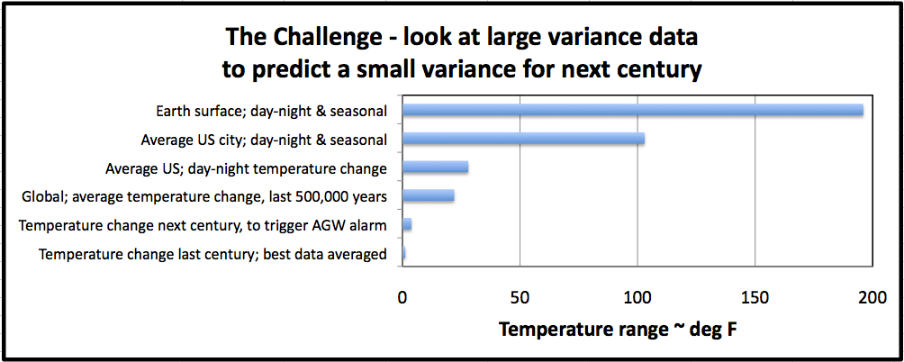
The Challenge is Massive for the Alarmist
To track and to forecast miniscule global-average temperature changes.
The temperature trend is so slight that, were the global average temperature change which has taken place during the 20th and 21st centuries were to occur in an ordinary room, most of the people in the room would be unaware of it. The CO2 % in this room will increase more during this talk than the atmospheric CO2 % did in the last 100 years.
Notes:
Last century’s global temp change was about 1 deg F. To credibly trigger an alarm, scientists must forecast at least a global temp rise of 2.2 deg F over the last century during the next 100 years. Most locations see 14 times that change every day and 50 times that change, every year.
Each scientist focuses on his tiny area of expertise or grant SOW, things like sea level, tree ring proxies, coral, sediments, etc. Those who tie it all together are in general NOT scientists but Science Evangelists (SE). Their challenge, is to provide a compelling story on something that is impossible, when looking at all the data, so they have to be selective and will always find data to support what they want or need to show.
I then lost interest in energy-efficient technologies until four years ago when I noticed something troubling about the challenges facing the global warming alarmists. I started my research on anthropogenic (i.e. man-caused) global warming (AGW) because, I found to my surprise, that to claim a catastrophic AGW theory as a “proof”, the climate scientists thought they only needed to show that human emissions MIGHT cause a fractional-degree global decadal temperature rise, for an earth that generally varies 20 to 40 deg F every 24 hours and varies as much as 80 to 100 deg F every year – This seemed to be a Herculean task indeed.
Also, the scientists have to do their crisis forecasting by accessing a myriad of disparate temperature data from often degraded sensors or temperature proxies for a chaotic global system. That system has had clear decadal sunspot variation, likely 500 to 2,000-year temperature cycles, routine 85k-year ice-age periods, etc - all caused by non-human effects. Even if global temperatures were the result of a single cause, the task of predicting future warming by the study of measured, conflicting surface/atmospheric/ocean data, would be difficult. With many chaotic causes (solar input intensity, precipitation, cloud formation, greenhouse gas warming, atmosphere-to-sea interactions, volcanoes, ocean currents, etc.), the task seemed overwhelming. In short, I observed that having adequate confidence in the data to make accurate, long-term global temperature predictions would likely be impossible.
Is it sensor/proxy inaccuracies (instrument error/scatter, inadequate coverage), or does the planet really react quickly to whatever causes the observed temperature swings? Regardless of which it is, any engineer who needs to make his important design or program conclusions/recommendations, based on analysis of available climate data, would conclude that it is not possible (or not ethical) to predict future fractional-degree decadal (or century) global temperature changes from this mess of scatter and conflicts.

Slide 11
The CAGW call to action (for a Carbon-constrained world).
Requires these 5 issues to be true.
This report studies these five, in order.
Recent human burning of fossil fuels suddenly and dangerously increased CO2 beyond previous levels.
Human CO2 emissions causes greenhouse warming.
Dangerous, sudden global warming occurred the last 50 years.
The current Temperature is too Hot & further warming is Bad.
It is more difficult to adapt to climate changes than to attempt to control them.
First, let’s address #1. Has our use of fossil fuels caused sudden, dangerous, unprecedented CO2 increase?
Notes:
You might think all 5 bullets are true, and that scientists have consensus - i.e., the debate is over.
But, at least 3 or 4 of them are in dispute among most scientists.
This pitch is an engineering review of the data and the way it has been presented and will show evidence that all 5 have been corrupted and are likely wrong; not just by the data handling, but the marketing of the results.
This presentation will address each of the five, in order.

Slide 12
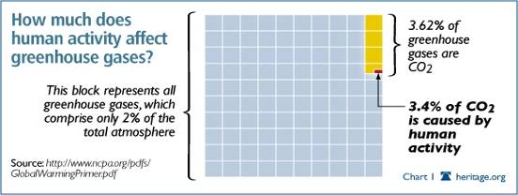
The Challenge is Massive for the Alarmist -
to prove his CO2 CAGW theory
He must convince us that CO2 is a pollutant. But calling it a pollutant is an uninformed joke. CO2, along with oxygen and water is essential for all life.
Look at a leaf, a grain, a flower. Half of what you see was made from CO2.
Human’s emissions of CO2 each year = 1 tablespoon in 300 gallons. So, take a tablespoon (360 drops) of warm water, slowly drip it into a 300-gallon drum of water (6 barrels) over one year at 1 drop every day.

Slide 13
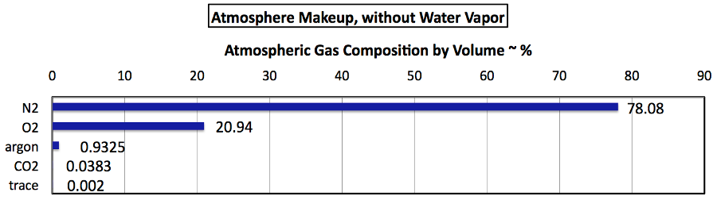
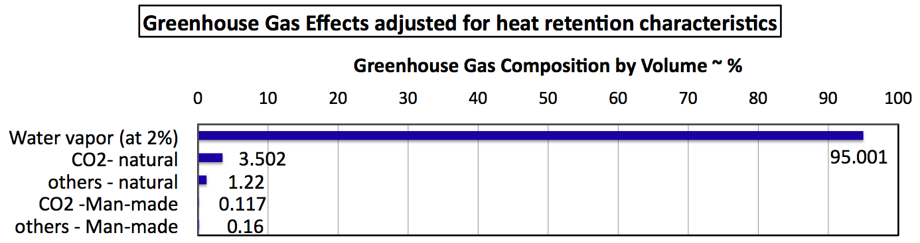
The Massive Alarmist’s Challenge
Carbon Dioxide content is very small, invisible on a bar chart.
Greenhouse gas effects of Human Emissions are also miniscule
Man’s emissions of CO2 contribute only 0.117%
of the total greenhouse gas warming effect.
Notes:
OIL GIANT GAVE £1 MILLION TO FUND CLIMATE SCEPTICS.
Hooray to Exxon for deciding to get out of the climate cabal’s blackmail and giving a few pennies to organizations that promote skepticism about man-made climate change, i.e. about anthropogenic global warming (AGW). Pennies? – Yes when compared to the AGW cabal’s propaganda machine having spent an alleged 100 billion dollars (10 billion dollars annually in the US alone) to promote their AGW fable. Fable? To wit: consider published estimates of annual global carbon dioxide emissions in Gt C/year (Gigatonnes of carbon per year):
Gt C/year
average
%
Respiration (humans, animals, phytoplankton)
43.5-52
47.75
22.96%
Ocean outgassing (tropics)
90-100
95
45.68%
Soil bacteria, decomposition
50-60
55
26.45%
Volcanoes, soil degassing
0.5-2
1.25
0.60%
Forest cutting, forest fires
0.6-2.6
1.6
0.77%
Anthropogenic emissions (2005)
7.2-7.5
7.35
3.53%
TOTAL
192-224
207.95
100.00%
No significant evidence exists that changes in atmospheric carbon dioxide
drive global temperature variations. The last 50 years of steady increase
in carbon dioxide of one molecule per 10,000 molecules of air every five
years has had no demonstrable effect on the multi-decade cooling and warming
cycles since 1979 when collection of this data set by satellite began to
augment other measurement sources. Cooling between 1935 and 1975 and after
2000 occurred even as a steady rise persisted in atmospheric carbon dioxide.
The slow long-term warming since the coldest portion of the Little Ice Age
(500-1900) shows no signs of acceleration during 150 years of
industrialization and use of fossil fuels. This warming has averaged about
0.9 degree Fahrenheit (0.5 degree Centigrade) per 100 years for the last 350
years.

Slide 14
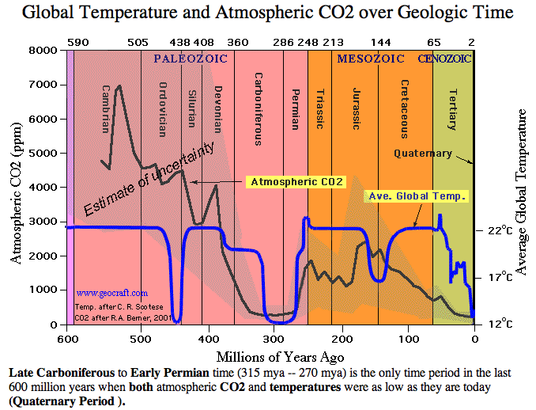
Looking back 600 million years
Atmospheric Carbon Dioxide was likely 18 times today’s concentration, during the Cambrian period when life’s diversity was at its greatest expansion (red circle). It was 4 times the current level when the dinosaurs were killed by an asteroid. The only other extended time CO2 was low, (like today) was a period 300 million years ago.
In the big picture we are now in a low CO2 period. The 20th century increase shows as an insignificant dot at this scale.
Do we risk runaway greenhouse warming if our CO2 concentration gets too high? CO2 has been scarce the last 2 million years. Also, it has never significantly driven temperature before.
Venus may have runaway greenhouse warming, but its CO2, at 96.5% is 2,500 times the level of CO2 in the earth’s atmosphere.
Now

Slide 15
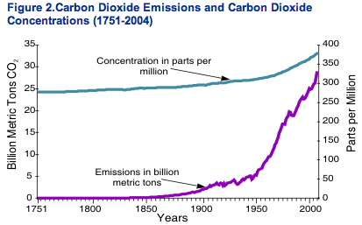
The Basic CO2 Alarmist’s Chart
The claim: CO2 content is smooth and near-constant for 200 years, and then increases, due to human emissions.
But - accurate CO2 direct measurements are only available for the last 50 years.

Slide 16
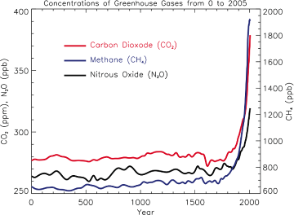
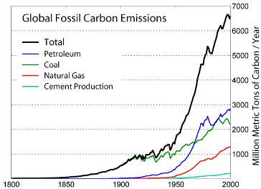
Another Scare chart
The Alarmist’ Presentation Tactic
Find a correlation of human emissions to something ‘really bad’. Scale the presentation to show a scare.

Slide 17
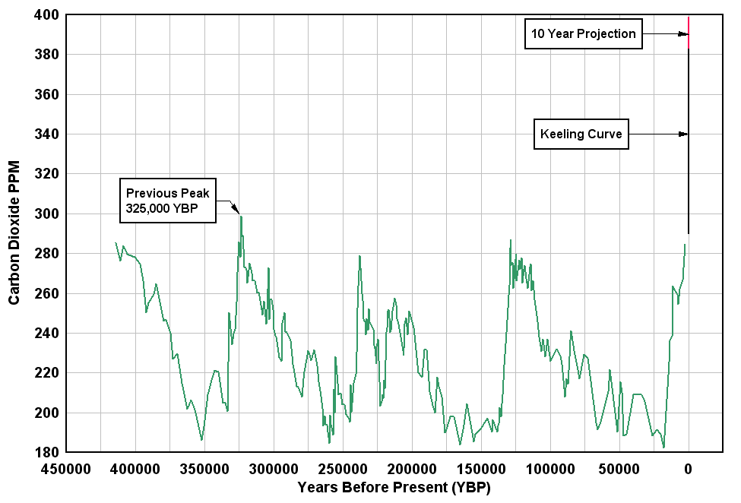
A Horrific scare chart
The Jump to Ice core data, back 400,000 years
“CO2 is highest in a million years”
Note the time scale.
Ice core data does not measure recent conditions.
Notes:
A study of stomatal frequency in fossil leaves from Holocene lake deposits in Denmark, showing that 9400 years ago CO2 atmospheric level was 333 ppmv, and 9600 years ago 348 ppmv

Slide 18
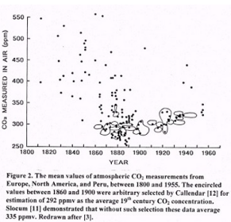
They selected only the circled data points that supported their theory.
Measured Atmospheric CO2
Manipulation of measured data for 200 years
Blue curve is the modern, accurate data, measured at Mauna Loa Observatory, Hawaii.
Green dashed curve is a fairing for all direct CO2 measurements, back to 1810.

Slide 19
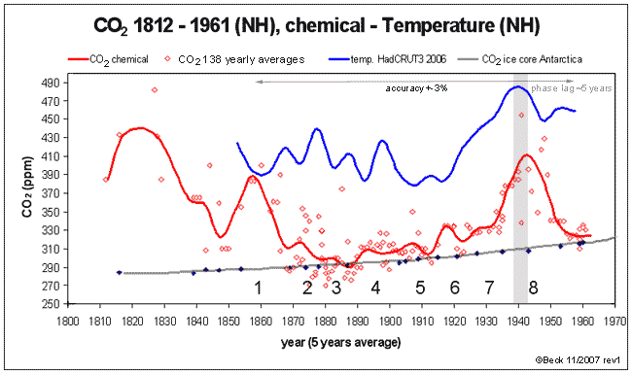
Another CO2 Measurement Method
Chemical method: data for 1810 to 1962 period.

Slide 20
The ‘Basic’ CO2 Chart
Now takes on a different look
Green dashed - Fairing of early, directly-measured CO2
Red - chemical method
Blue - Mauna Loa modern measurements

Slide 21
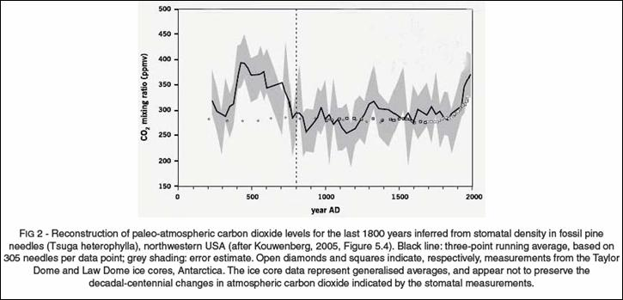
Looking Back 1800 years
A CO2 Measurement Proxy
From stomatal density in fossil pine needles

Slide 22
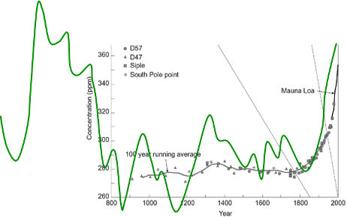
Summary: CO2 Data for the last 1800 years
Data from early & modern measurements, Ice core, chemical and pine needles. Not a lot to scare, with this chart.
Is the present CO2 increase not unusual, or are pine proxies not reliable? Of course, alarmists might say the latter - until they consider the pine tree rings that brought them their most-deceptive chart of all - The hockey stick.
Dashed green - early direct measurements
Green - stomatal density in fossil pine needles
Black - ice cores, 4 locations
Red - chemical method
Blue - modern, Mauna Loa direct measurements
This chart informs (five data sources), but does not scare. It illustrates the significant scatter seen in the various methods for CO2 historical data.
For the proper perspective this data is transferred to the next slide.
360
CO2 Concentration ~ ppm
260
1000 Year 2000

Slide 23
Now, to put Atmospheric CO2 in Perspective
This chart is presented to Inform, not to Scare.
This shows CO2 in its proper role as a trace gas, not something that has to be immediately eliminated.
0.5%
Normal human CO2 limits for a confined space. OSHA Industry, submarine or ISS space station (13 times the current atmosphere).
0.4%
Note: Apollo 13 LEM went to 2%, 53 times the current global atmosphere.
Above 30% (780 times the current global atmosphere), CO2 causes death in humans.
Note: Water Vapor (a greenhouse gas) varies up to 4.0% (100 times CO2).
0.3%
CO2 - % of Atmosphere
Average atmospheric CO2 content, during development of plant and animal life on earth (approximately 8 times current). Also, an ‘optimum’ level for species diversity, crop yields and tree growth.
0.2%
Atmospheric Carbon Dioxide Gas, CO2
- Current CO2 0.038%.
Red - Chemical measurement + Mauna Loa data.
Green - from stomatal density in pine needles.
Black - ice core data.
Dashed - early measurements.
CO2 %, indoors, in an average house
0.1%
0
0
1000
AD
2000
AD

Slide 24
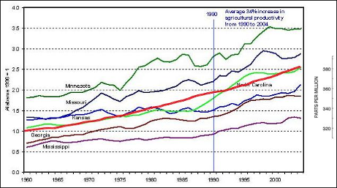
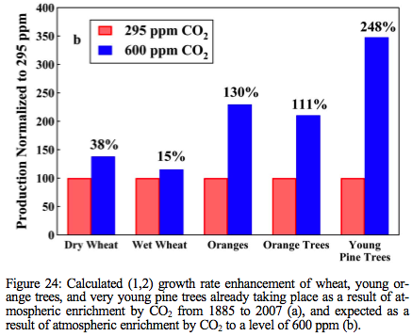
Agricultural productively increased an average of 34% from 1990 to 2004. Much of that increase was due to the increase in atmospheric CO2.
Plants need less water, with more CO2.
A Pollutant?
No, CO2 is critical for life
A doubling of CO2 would greatly improve crop yields & forest growth. Decreasing CO2 to half the current % would be catastrophic (plants die, humans starve.
A claim:
About 500 million people (7% of today’s population) are alive today, who wouldn’t be, if carbon dioxide had not risen in the last century.
http://www.co2science.org/subject/t/summaries/earlyspringgrowth.php
Notes:
http://www.co2science.org/subject/t/summaries/earlyspringgrowth.php
Lo and behold, the first 20 ppm accounts for over half of the heating effect to the pre-industrial level of 280 ppm, by which time carbon dioxide is tuckered out as a greenhouse gas. One thing to bear in mind is that the atmospheric concentration of CO2 got down to 180 ppm during the glacial periods of the ice age the Earth is currently in (the Holocene is an interglacial in the ice age that started three million years ago). Plant growth shuts down at 150 ppm, so the Earth was within 30 ppm of disaster. Terrestrial life came close to being wiped out by a lack of CO2 in the atmosphere. If plants were doing climate science instead of us humans, they would have a different opinion about what is a dangerous carbon dioxide level.

Slide 25
The danger is too-low atmospheric CO2
While we refer to ice ages usually as the glacial periods that have happened routinely every 100k years during the last million or 2 years, the whole of the last several million years has actually been a relative ice age. Before that, during diversity growth from sea life through dinosaurs, the planet was much warmer, with little ice at all, sea levels hundreds of feet higher and in general, GREEN from pole to pole. It was green, not dry desert because the earth was fertilized by CO2 levels 10 to 20 times present.
One thing to bear in mind is that the atmospheric concentration of CO2 got down to 180 ppm during the glacial periods of the ice age the Earth is currently in (the Holocene is an interglacial in the ice age that started three million years ago). Plant growth shuts down at 150 ppm, so the earth was within 30 ppm of disaster (dry deserts and starving plant life).
Terrestrial life came close to being wiped out by a lack of CO2 in the atmosphere.

Slide 26
Next is #2. Okay, so CO2 is not a problem for plants, animals and humans, but is it causing the planet to get warmer via the greenhouse effect?
#1. - Increase? Yes - Due partially to human emissions, the atmospheric content of CO2 has increased 20% in the last 50 years. CO2 might now be the highest in the human era.
However, CO2 is only 0.038% of the atmosphere and CO2 is only 3.6% of all the greenhouse gasses.
Dangerous increase? No, not unless it causes a dangerous result. Dangerous? yes, if it decreases 50%.
CO2 is a trace gas; it has been 18 times current levels during times of life’s greatest species diversity growth. Increases are beneficial.
Recent human burning of fossil fuels suddenly and dangerously increased CO2 beyond previous levels – Yes/No
Human CO2 emissions causes greenhouse warming.
Dangerous, sudden global warming occurred the last 50 years.
The current Temperature is too Hot &further warming is Bad.
It is more difficult to adapt to climate changes than to attempt to control them.

Slide 27
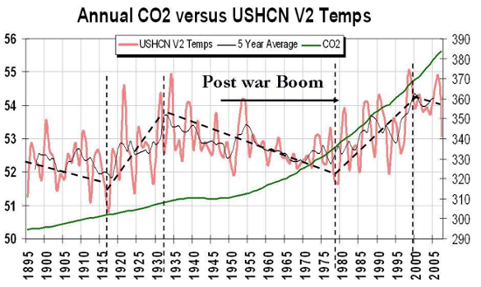
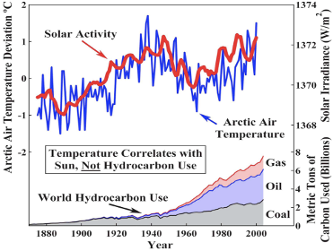
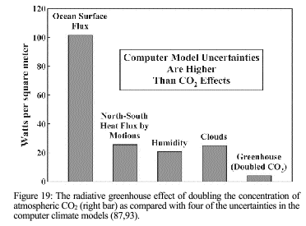
Assessing the Blame for Global Warming
Atmospheric warming with human carbon emissions shows ‘good’ correlation only after 1970.
These four uncertainties in the Climate Models swamp the warming due to doubling atmospheric CO2.
Notes:
27

Slide 28
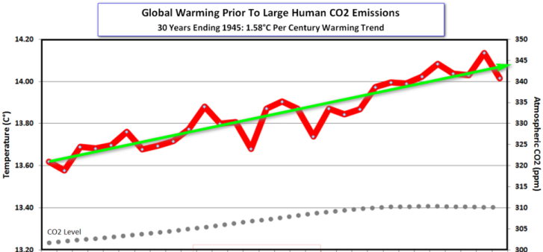
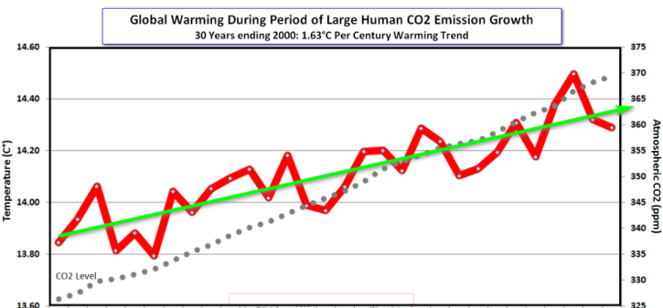
A Comparison, for the two most-recent warmings:
“Natural” Global Warming vs. “CO2-caused” Global Warming.
Warming Prior to Large Human CO2 Emissions.
1915 to 1945 with 2.7% rise in CO2
The two 30-year warming periods are nearly identical, in spite of large differences in emissions and atmospheric CO2 levels.
Global temperatures cooled from 1945 to 1970, even though CO2 rose by 5%.
The “Correlation With Human emissions” claim is baseless.
Green Slope = 1.58 deg C per century
Warming During Large Human CO2 Emissions.
1970 to 2000 with 13.2% rise in CO2
Green Slope = 1.63 deg C per century
Data graphs from C3headlines.com

Slide 29
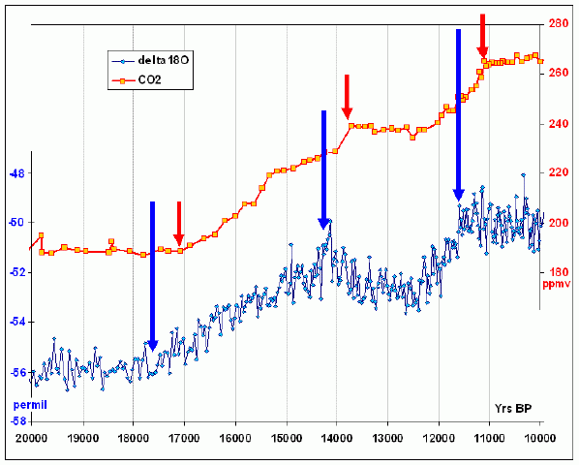
Temperature Increases Drive CO2 Rise, Not Vice Versa
CO2 changes happen after temperature changes.
Data basis - ice cores.
This chart shows a 10,000-year period during the last ice age recovery. The temperature changes, then CO2 responds 500 to 800 years later.

Slide 30
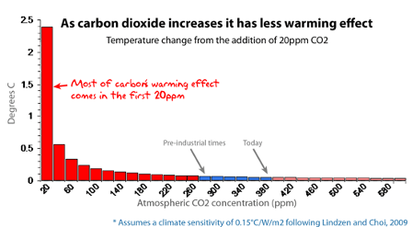
The Big Greenhouse Gas Warming Effect
is only for small amounts of CO2
Doubling the concentration now would have little effect on warming.
The CO2 already in the atmosphere absorbs most of the light it can. The CO2 only “soaks up” its favorite wavelengths of light and it’s close to its saturation point. It can’t do much more, because there are not many left-over photons at the right wavelengths.
The natural greenhouse effect is real, and it helps keep us warm, but it’s already nearly reached its peak performance. Add more CO2 and most of the extra gas is just “unemployed” molecules.
Notes:
Lo and behold, the first 20 ppm accounts for over half of the heating effect to the pre-industrial level of 280 ppm, by which time carbon dioxide is tuckered out as a greenhouse gas. One thing to bear in mind is that the atmospheric concentration of CO2 got down to 180 ppm during the glacial periods of the ice age the Earth is currently in (the Holocene is an interglacial in the ice age that started three million years ago). Plant growth shuts down at 150 ppm, so the Earth was within 30 ppm of disaster. Terrestrial life came close to being wiped out by a lack of CO2 in the atmosphere. If plants were doing climate science instead of us humans, they would have a different opinion about what is a dangerous carbon dioxide level.

Slide 31
Using Computer Models
to Predict Future Climate Changes
Engineers and Scientists know that you cannot merely extrapolate data that are scattered due to chaotic effects. So, scientists propose a theory, model it to predict and then turn the dials to match the model to the historic data. They then use the model to predict the future.
A big problem with the Scientist - he falls in love with the theory. If new data does not fit his prediction, he refuses to drop the theory, he just continues to tweak the dials. Instead, an Engineer looks for another theory, or refuses to predict - Hey, his decisions have consequences.
The lesson here is one that applies to risk management
“Question, Never Defend” *
Note that NONE of the dozens of computer models predicted the last decade of cooling. Excuses and dial-tweaks were made after the fact.
The following charts show examples of poor IPCC predictions of warming, even though they can accurately tie emissions to CO2 rise. This discredits the theory of greenhouse-gas-warming being the primary warming cause.
* Rutan policy for aircraft flight safety reviews and always enforced for Flight Readiness Approvals.

Slide 32
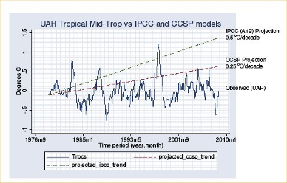
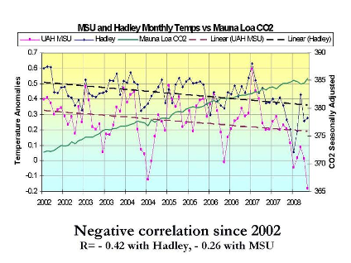
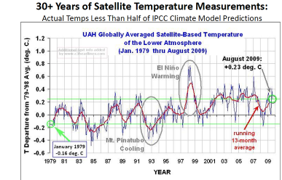
Climate models fail to Predict
News Media and Nature magazines often report that Global Warming is “worse than predictions”. In the vast majority of cases, they are wrong.
Atmosphere Temperature Prediction
Blue = prediction slope (low range) Red = actual data
UN IPCC Prediction
Blue = prediction range (high and low) Red = actual data

Slide 33

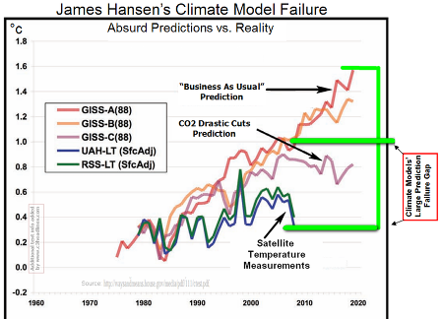
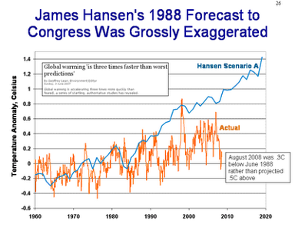
NASA’s James Hanson
Calling the computer models “evidence” in Congress in 1988, Hanson predicted a leveling of warming by 2006, ONLY if drastic cuts were made in emissions.
Real data - it is cooler, WITHOUT the cuts. The planet is now the same temperature as when he testified.
Strangest fact - He is still invited to congress to scare the inmates. Maybe he should have been muzzled after all?
Blue = prediction Red = actual data fairing
Blue = prediction Red = actual data fairing
Notes:
From The Telegraph, November 16, 2008A surreal scientific blunder last week raised a huge question mark about the temperature records that underpin the worldwide alarm over global warming. On Monday, NASA’s Goddard Institute for Space Studies (GISS), which is run by Al Gore’s chief scientific ally, Dr James Hansen, and is one of four bodies responsible for monitoring global temperatures, announced that last month was the hottest October on record….. In the US, the National Oceanic and Atmospheric Administration registered 63 local snowfall records and 115 lowest-ever temperatures for the month, and ranked it as only the 70th-warmest October in 114 years.
So what explained the anomaly? GISS’s computerized temperature maps seemed to show readings across a large part of Russia had been up to 10 degrees higher than normal. But when expert readers of the two leading warming-skeptic blogs, Watts Up With That and Climate Audit, began detailed analysis of the GISS data they made an astonishing discovery. The reason for the freak figures was that scores of temperature records from Russia and elsewhere were not based on October readings at all. Figures from the previous month had simply been carried over and repeated two months running.
The error was so glaring that when it was reported on the two blogs – run by the US meteorologist Anthony Watts and Steve McIntyre, the Canadian computer analyst who won fame for his expert debunking of the notorious “hockey stick” graph – GISS began hastily revising its figures. This only made the confusion worse because, to compensate for the lowered temperatures in Russia, GISS claimed to have discovered a new “hotspot” in the Arctic – in a month when satellite images were showing Arctic sea-ice recovering so fast from its summer melt that three weeks ago it was 30 per cent more extensive than at the same time last year.

Slide 34
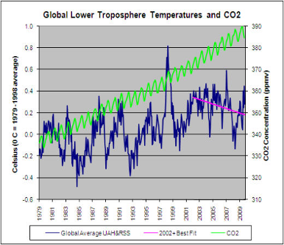
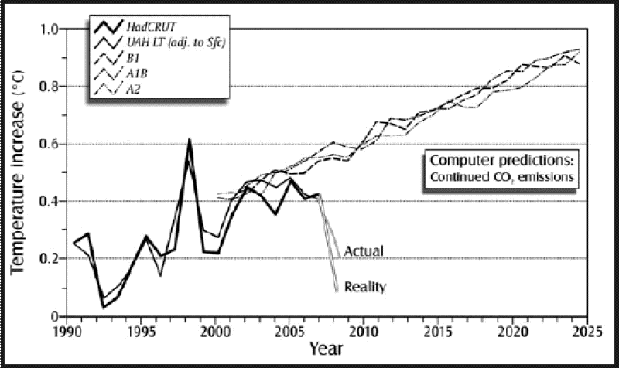
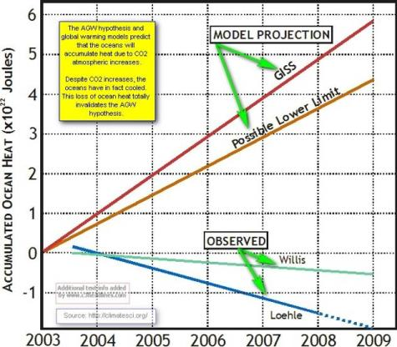
More Failed Predictions from the Computer Models
Five computer models predict greenhouse warming.
Data show no support for model’s validity
Troposphere Temps, a 31 year Trend
Blue = 2.5 deg/century slope Red = data trend
Blue = model prediction, 2.2 deg/century Red = actual data
Ocean heat:
Opposite of prediction.

Slide 35
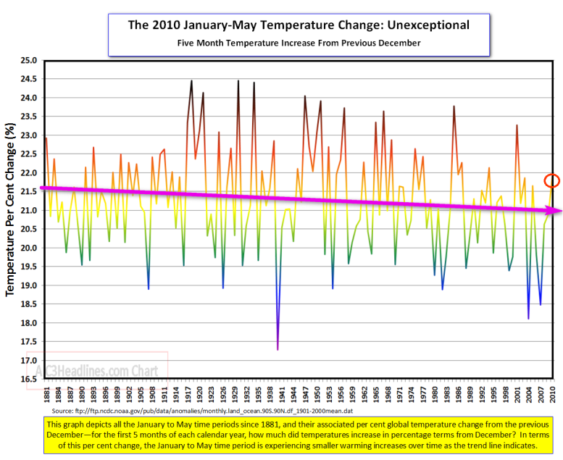
Effective Propaganda: A News Headline from June, 2010
“May, 2010 was the hottest May on record”
The intended result - you now think that dangerous Global Warming is back, after the cold winter of 2009.
The truth - summer heat recovery is not exceptional in the human-emissions era.
Graph is for the last 130 years. Summer heat recovery extent has declined and is unchanged by human emissions.

Slide 36
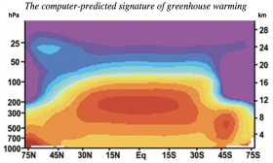
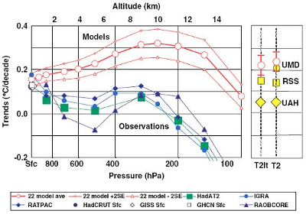
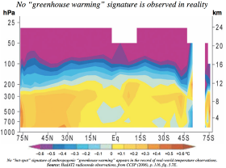
A Generic Problem With Greenhouse Warming Models
The character and distribution of the warming in the atmosphere (as measured) is dramatically different than predicted by the climate computer models. This brings the model’s assumptions into question.
How can we rely on the warming predictions, if the models incorrectly predict atmosphere warming?
Model predicts hot spot at 8 to 13 km for mid latitudes
Models show warming rate (deg C per decade) at 4 to 14 km altitude, while measurements show rate is flat to 10km, then cool above.
But, the atmosphere does not warm at 8 to 13 km altitude
Notes:
Conclusion
Though correlation does not always imply causation, and absence of correlation does not always imply absence of causation, atmospheric physics would lead us to expect what is in fact deduced from observation: that approximately five-sixths of global temperature anomalies are attributable to variations in outgoing long-wave radiation in the tropics; that these variations owe nothing to anthropogenic “global warming”; and that increases in the concentration of carbon dioxide are comparatively insignificant. This last conclusion is supported, to some extent, by the limitations on the definition and extent of the scientific “consensus” on climate sensitivity to additional greenhouse-gas concentrations (Oreskes, 2004; IPCC 2007).The UN’s fourth assessment report on climate change (IPCC, 2007) confirms that computer modeling predicts the existence of a unique and distinct signature or fingerprint of anthropogenic warming caused by our emissions of greenhouse gases. That signature is the instantly-recognizable tropical, mid-troposphere “hot spot” about 10km above the Earth’s surface. In the “hot spot”, the models predict that the rate of increase in atmospheric temperature, measured in degrees Celsius per decade, will be two or three times greater than at the Earth’s surface. In IPCC (2007), this predicted “hot-spot” signature of anthropogenic greenhouse warming is clearly visible on plots of modeled greenhouse forcing and of all forcings including the dominant greenhouse forcing, but is not visible on plots of solar, volcanic, tropospheric and stratospheric ozone, or sulphate aerosol forcings. The UN’s models accordingly distinguish clearly between greenhouse warming and other climate forcings: at least five separate general-circulation computer models of the climate all predict the existence of the “hot-spot” signature of anthropogenic greenhouse warming in the tropical mid-troposphere. Yet in the plot from the Hadley Centre’s radiosondes, showing actual, observed temperatures in the troposphere, presented in the same altitude-vs.-latitude fashion as the predictions made by the five computer models, the computer models’ repeatedly-predicted “hot-spot” signature of anthropogenic greenhouse warming is entirely absent. Indeed, very nearly all observational data on mid-tropospheric temperature trends over the past half-century show no tropical “hot-spot” at all; and, in the one record that shows it at all, the magnitude of the observed effect is insufficient to justify the UN’s choice of a very high central estimate of climate sensitivity to anthropogenic enhancement of the greenhouse effect. Our own small experiment also fails to demonstrate even the existence of the “hot-spot” fingerprint of anthropogenic warming, still less a magnitude sufficient to justify the IPCC’s high climate sensitivity. These surprising results present a very real difficulty for the conventional “global warming” theory – a difficulty that is not resolved either in CCSP (2006) or in IPCC (2007).Thorne et al. (2007) have attempted to resolve this difficulty by suggesting that the error-bars in the observational datasets are so large that they could in theory encompass the model-predicted “hot-spot”, that the datasets are not designed to identify small temperature trends, and that the outputs are exceptionally sensitive to the choice of limiting dates. However, it is on the basis of the observed data that the models are contrived, and, if the observed data are inadequate for drawing conclusions about whether the characteristic fingerprint of anthropogenic greenhouse warming exists, then a fortiori the outputs from theoretical models founded upon those data will be inadequate, and no conclusion about the magnitude of the temperature response to anthropogenic enhancement of the natural greenhouse effect can be legitimately drawn. The observational and experimental graphs reproduced here contain between them a dozen different observed- temperature datasets, not one of which exhibits the “hot-spot” signature of anthropogenic “greenhouse warming” that is predicted by the computer models upon which the UN so heavily relies. In every one of these datasets, the trend in the troposphere is no greater, and generally smaller, than the trend near the surface. According to Spencer et al. (2007), the tropospheric temperature trend is now 0.05 ± 0.07 degrees Celsius per decade. Therefore, the contribution of the anthropogenic enhancement of the greenhouse effect to surface warming is somewhere between -0.02 and 0.12 degrees Celsius per decade, with a central estimate of 0.5 degrees Celsius, or approximately one- sixth of the UN’s central estimate of 3 degrees Celsius for a doubling of atmospheric carbon dioxide concentration. This result is broadly consistent with that of Schwartz (2007), who supports the conclusions of Lindzen (2006), calculating by entirely different methods that the temperature increase to be expected from a doubling of atmospheric carbon dioxide concentration will be one-half to one-third of the UN’s central estimate. Can the discrepancy between prediction and observation be explained, as the CCSP suggests, by uncertainties in the observed data? The very close correlation between anomalies in tropical outgoing long-wave radiation and anomalies in global lower-troposphere temperatures, taken with the near-total absence of correlation between monotonic increases in CO2 concentration and chaotic temperature anomalies, suggests that it is the computer models, not real-world observations that are likely to be at fault. Ultimately this question can only be resolved by collecting further data: but the CCSP’s predisposition in favor of theoretical modeling and against the results of direct observation is commonplace among official climate-science bodies. Or does the discrepancy arise because the predictions are carried through to equilibrium climate response, while the observations are perforce carried only to a transient response? Professor Lindzen comments that this failure of observation to match prediction cannot be so easily explained, since the transient response would be likely to exceed the equilibrium response. He concludes that no more than about a third of the observed trend at the surface is likely to be due to greenhouse warming, and adds: “This is about as close as one ever gets to proof in climate physics.” On this analysis, “global warming” is unlikely to be dangerous and extremely unlikely to be catastrophic.

Slide 37
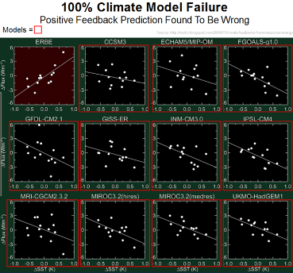
Are the Greenhouse-Gas-Warming
Computer Models Wrong?
Climate models generally assume positive feedback Greenhouse gas warming, while some actual measurements indicate negative feedback.
The measured data show
negative feedback.
The eleven computer models assume positive feedback.
Bottom line: we really do not know for sure what the feedbacks are. The real world climate may operate opposite from the model assumptions. Thus, warming caused by emissions may be only a small fraction of the IPCC model prediction.

Slide 38
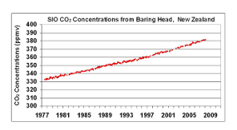
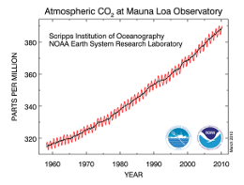
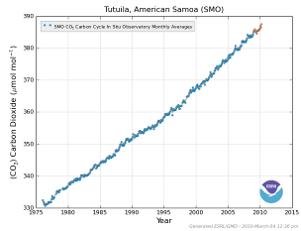
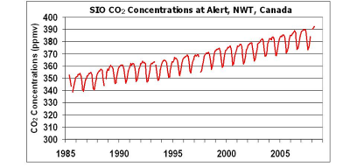
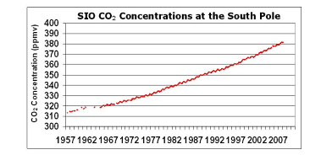
Greenhouse Models Cannot Predict Future Warming
But, what can be used for prediction?
If the engineer can find consistent, accurate, redundant data, he often extrapolates it to predict the near future.
One climate data set that qualifies is the modern measurement (last 50 years) of atmospheric CO2. Data fairings on the next slide.
Notes:
Use all measurements, not just the Mauna Loa one, located 32 miles downwind of Kilauea, one of two currently erupting volcanoes in the US.
Lets predict, based on extrapolating real data, something engineers do all the time. It has to be done carefully, since it must have a basis in science and all the data must be looked at to see if a confident extrapolation can be supported.
Most data sets cannot be extrapolated, due to random scatter, chaotic behavior and unknown effects. ALL climate models failed to predict the last decade cooling.
Conclude that direct measurement of CO2 the last 30 to 50 years with modern lab equipment is the ONLY thing that can be confidently sloped into the future. Also, very important, we can make a case that the increase is tied to human emissions. That lets us predict the future of CO2 content in the atmosphere, based on an assumption that human emissions will continue while we are still using fossil fuels for our energy.

Slide 39
A Close look at Modern CO2 Measurements
Accurate enough for prediction? Yes, at least on a short term.
Red = South Pole
Black = Mauna Loa
Blue = Tutuila, American Samoa
Green - Baring Head, New Zealand
Orange = Alert, Canada
Slope for extrapolation
1.78 ppm per year = only 0.000178% per year.
1980
2000
380 ppm
Note: This is NOT a climate computer model, just an extrapolation of accurate, scatter-free, measured CO2 data.
320 ppm

Slide 40
The CO2 prediction.
In perspective.
380 ppm
1980
320 ppm
2000
0.1%
Ratio data down to a useable scale for prediction
Slope = 0.000178% per year
Zero
2000 One Hundred Years 2100

Slide 41
A Carbon Dioxide Prediction
An extrapolation of the accurate modern measurements.
An estimate of what might happen without Government’s taxing energy.
This Chart is structured to Inform, not to Scare.
0.2%
Atmospheric Carbon Dioxide Gas, CO2
- Current CO2 0.038%.
Multi color – Modern measurements (last 50 years)
Blue dashed line - extrapolation of modern measurements
Crop yields up > 35%.
Pine trees growth doubles.
CO2 - % of Atmosphere
0.1%
CO2 %, indoors, in an average house
?
?
Oil, coal, and natural gas gets more expensive than non-CO2 emission energy, without Government taxing (approximate guess).
0
0
2000
21st Century
2100
2200
2300
Notes:
This chart is presented to INFORM, not to SCARE. The dashed blue line extrapolates the accurate CO2 direct measurements. Two more centuries just like the last, will not be catastrophic, but we do not have enough fossil fuels to continue the last 50 years of emissions.
However, do note that we cannot use high CO2 levels to warm the planet beyond tiny levels, as we will see later. It cannot be used to eliminate the next ice age (our biggest threat, after Asteroid hits and Yellowstone blowing up).
What is an “optimum” level of CO2 in the atmosphere? No one knows, but it is likely several times the current concentration, an amount that would occur in 800 to 1200 years if the current rate of increase were to continue. However, CO2 will drop after the planet’s temperature drops in its historical cycle of cyclic ice ages.
Oil will naturally get expensive due to its rarity- a natural rarity creates the best research for alternatives without destroying economies (compared to Governments artificially making it expensive). Thus, is it not better to use fossil fuels EARLIER???

Slide 42
Notes on continuing our use of fossil fuels
An “optimum” CO2 level for plants and animals would be reached in about 1000 years if the current rate of emissions could be continued.
We do not have enough fossil fuels to drive the atmospheric level of CO2 to anywhere close to a dangerous level.
Two more centuries of emissions like the last are not possible and not dangerous.
Using all the reserves of fossil fuels now, would have little effect on global temperatures (beyond the natural warming).
CO2 level will drop, in response to decreasing temperatures about 500 to 800 years after the planet experiences its normal 90k-year cycle – cooling into the next big ice age.
We cannot burn fossil fuels to prevent the next ice age – the greenhouse gas effect is far too weak for that.
Since our current fuels (coal, oil, natural gas) are non-renewable, as they become scarce their cost will force a change to alternatives without Government control or Tax. This market-driven change will occur earlier if Governments do not constrain use of the current fuels.

Slide 43
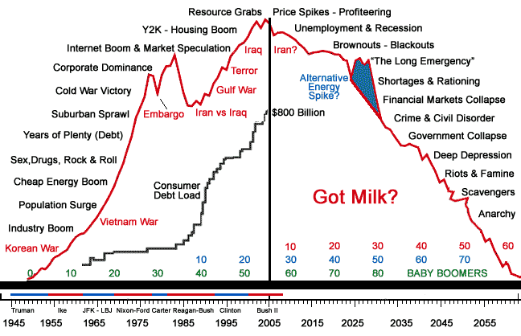
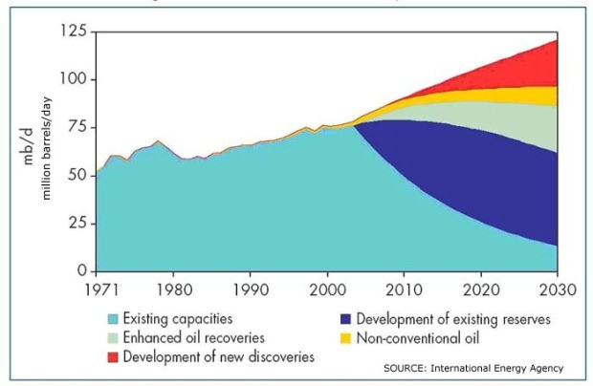

Peak Oil
  Defined as being near since the 1930s
  Technology always extends the prediction
Most predictions of “Peak Oil” do not consider advances in technology; this one does.
Peak Lithium (for Batteries)
  Demand will soon increase cost
  But, technology develops alternatives.
Peak Neodymium (rare earth for motor magnets)
  China already limiting exports
  But, technology discovers alternatives.

Slide 44
1. How Much Human Energy Is Contained in One
Gallon of Gas?
From Dr. David Pimentel:
"That is, the 38,000 kcal in one gallon of gasoline can be transformed into 8.8 KWh, which is about 3 weeks of human work equivalent. (Human work output in agriculture = 0.1 HP, or 0.074 KW, times 120 hours.)"
He, of course, is accounting for the energy lost in the process of converting the gasoline into usable energy.
My calculations excluding the energy lost in the conversion process are as follows:
1 Gallon of Gas = 125,000 BTUs
Source: US Department of Energy
3,400 BTUs = 1 KWH
Source: US Department of Energy, Bonneville Power Mgt.
1 Gallon of Gas = 37 KWH
(125,000 BTUs in a gallon of gas divided by 3,400 BTUs in 1 KWH)
1 Gallon of Gas = 500 hours of human work output
(37 KWH in 1 gallon of gas divided by human work output in agriculture of .074 KW = 500)
4. How Many Wind Turbines Would It Take to
Replace a Single Off-Shore Drilling Platform
Producing 12,000 Barrels of Oil Per Day?
"Let's say that this oil was destined to be converted into electricity at an overall efficiency of 50 % (Combined Cycle Plant, no co-generation). Assuming this was decent quality oil, and not overly burdened with a high sulfur content, this oil would go to make about 10,800 bbls/day of refined products (10 % of it is used to power the refinery/transport the oil). And lets
assume the oil had an average thermal content of about 140,000
Btu/gal."
"Using 42 gallons/bbl and a 50 % conversion factor, 1 bbl/day could deliver about 861.2 kw-hr of electricity per day, or about 314.5 MW-hr/yr."
"Where I live (New York), a single Vestas V82 wind turbine placed near the Lake Erie coastline would produce more than 5400 MW-hr/yr. This one turbine would thus be the equivalent of 17 bbls/day of oil used to make electricity. And a lot of oil is burned to make electricity in New York State, in addition to significantly more natural gas."
"Thus it would take 706 Vestas V82 wind turbines to produce the same amount of electricity that could be made with your
12,000 bbl/day oil well."

Slide 45
Greenhouse CO2 Effect is a minor player in global warming
The important climate thermostats are too chaotic to model:
  Precipitation and Cloud formation; A <2% precipitation change more than offsets a doubling of CO2, but rain and clouds are too chaotic to model, even short term.
  The Pacific heat vent; observed and powerful, but cannot be modeled. It is also a stable, temperature control thermostat.
Water vapor is the primary greenhouse gas, overwhelming CO2, but even the EPA will not call water a “pollutant”.
The “clouds and humidity” factor is chaotic and bogglingly complex. High clouds tend to warm the planet but at the same time, low clouds tend to cool it. Which effect rules?
Notes:
This is probably the most important slide of the whole pitch.
Other effects are much stronger than Human Carbon emissions’ effect on GHG; And these effects are stable “control thermostats”, not “tipping points”. They are too chaotic to model.
These effects will easily control global temperatures until we drop toward an ice age, in spite of us adding huge amounts of Plant Food to the atmosphere. This is why most scientists now do not think our emissions will cause a climate catastrophe (recent pronouncements from Russia, Czechoslovakia, India, China, Australia and many other countries.
Why then the continuing focus on human-caused greenhouse gas? It is the only one that can be modeled to show a reliable affect on global temperatures, short and long term (abet in the absence of other effects, of course, i.e. assuming there are no other effects). It is not cause for alarm, but it is the only man-caused effect that can be supported by scientific calculation.
45

Slide 46


Earth orbit cycles and sunspots
Are likely drivers of warming cycles
Combining Ecliptic and Elliptical orbits correlates with last 60k years’ temperatures and predicts future climate.
Sunspots correlate with last 1,000 years temperatures.

Slide 47
Where is the evidence that human emissions cause greenhouse global warming?
Computer models are not evidence.
There once was supporting evidence on greenhouse feedback extent. However, there are now at least three independent pieces of evidence that the temperature rises predicted by the IPCC due to CO2 emissions are exaggerated by a factor of between 2 and 10. The scientists have assumed overly-positive water vapor feedback in the climate models.
Chapter 9 of IPCC latest Assessment Report 4 (2007), “Understanding and Attributing Climate Change”, contains no evidence. The claim that CO2 is the main cause of the recent global warming is an assumption, repeated numerous times. But repetition is not proof, and the scientists and policy makers’ summary report presents no actual evidence.

Slide 48
Next is #3. OK, we are done with looking at CO2. Lets now look at global temperatures: did the planet indeed experience sudden, dangerous warming in the last 50 years?
#2 - Emissions caused greenhouse warming?
Not likely, and not supported by data.
There is no evidence that carbon dioxide emissions are the main cause of the recent global warming.
Our small warming/cooling cycles are mainly caused by chaotic formation of clouds/precipitation and solar input variation, not by CO2 greenhouse effects.
Despite spending $billions over the last 20 years looking for evidence, the scientists have found none. In two instances they expected to find it, but in both cases they found only evidence of the opposite.
Recent human burning of fossil fuels suddenly and dangerously increased CO2 beyond previous levels – Yes/No.
Human CO2 emissions causes greenhouse warming – No.
Dangerous, sudden global warming occurred the last 50 years.
The current Temperature is too Hot & further warming is Bad.
It is more difficult to adapt to climate changes than to attempt to control them.
Notes:
Humans are less than 1 millionth of the earth’s biomass.
Termites produce more CO2 than humans. Farm animals produce more GHG than all the vehicles on the road.
Ants outweigh us by a factor of 100, and we do not really know what they are up to…….
How, can this minuscule mass possibly be responsible to fry, or otherwise destroy the earth? It makes no logical sense. That is why I recently got interested in looking at the data and seeing what assumptions were being made.
I found that no conclusion on human GHG-blame could be made if one honestly considers the other causes. This is supported by the observation that the climate likely has always had at least today’s temperature swings, in the absence of any significant human activity. Also, the GHG warming effect is primarily driven by water vapor, not by CO2, and the human emissions’ portion of atmospheric CO2 is tiny.

Slide 49
Looking again at the UN temperature scare
This chart includes a large number of predictions - all of them showing big problems or catastrophe in the next century.
None of the predictions are based on reliable, tested evidence. Most of the data shown in this chart are now known to be wrong.
Range of IPCC temperature predictions for the next Century.
Red Circle is the claimed AGW scare

Slide 50


Looking Back Millions of years
Now
Now
We are in a comparative cold period and the 20th century warming is insignificant.
Runaway greenhouse destruction of our planet would have happened in the distant past (if catastrophic greenhouse theory were correct).

Slide 51

More Recent Global Temperature Data
Looking Back 400,000 years
The current, 11,000-year non-glacial warm period is the longest running and the COLDEST one in the last half million years. The four previous interglacial warm periods were all warmer than the current one (data in the black ovals).
The recent 1,000 years’ temperatures were completely normal (red line in the red circle), among the recent 11,000-year warm period.
Remember; recent CO2 increase is unusual, but not global temperature -
further indication that emissions are not the driver of Global Warming.
Notes:
Note that the temp of the last 1000 years is not unusual at all among the last 10k yr. The co2 is unusual for the recent 10kyr, but the fact that it did not trigger unusual warming indicates that the GHG theory is invalid and the argument that a “tipping point” could happen if CO2 got much higher is proved wrong. If not the tipping point would have happened most times in our more distant past.

Slide 52




Surface Thermometer Measurements
and the ‘urban-heating’ proof
The number of stations grossly changed when Soviet union fell - biasing the calculation of Global Average Temperature. Soviets had paid outposts for fuel based on how cold they were. Then, ‘warming’ happened when the policy was ended.
California shows no warming in counties that did not have a big increase in population during the last 100 years.
Population locally biases the sensors hotter.
Notes:
Soviets paid the most money to buy oil to the coldest outposts. Once that policy fell with the Soviet gov’mt, the temps went up. The closure of sites vs.. global temps. Russian scientists now publicly say that the GW data is useless.

Slide 53








Surface Thermometer Measurement (2)
90% of US sensors do not meet site quality standards.
Local effects, added recently, all bias the temperature higher.

Slide 54





Surface Thermometer Measurement (3)
Data manipulation
The Darwin Australia “Adjustments”
Blue = raw data Red = Adjusted Black = the arbitrary adjustment.
US surface temp, presented by NASA in1999
Urban-Heat Corrections of Central Park
Infers NYC depopulated 1987 to 2006!
The same data were later ‘adjusted’ by NASA GISS
Notes:
Surface temp fraud.pdf
In a volunteer survey project, Anthony Watts and his more than 650 volunteers www.surfacestations.org found that over 900 of the first 1067 stations surveyed in the 1221 station US climate network did not come close to meeting the specifications. Only about 3% met the ideal specification for sites. They found stations located next to the exhaust fans of air conditioning units, surrounded by asphalt parking lots and roads, on blistering-hot rooftops, and near sidewalks and buildings that absorb and radiate heat. They found 68 stations located at wastewater treatment plants, where the process of waste digestion causes temperatures to be higher than in surrounding areas. In fact, they found that 90 percent of the stations fail to meet the National Weather Service’s own siting requirements that stations must be 30 meters (about 100 feet) or more away from an artificial heating or reflecting source.
The net warming in the urban heat-island adjusted GISS US dataset from the peak around 1930 to the peak near 2000 was a meager 0.15 C°. It may be assumed the same would be true for the world if we could make a similar needed urban heat-island adjustment.39 http://climateaudit.org/2009/06/29/the-talking-points-memo/.42GISS Adjusted US Temperatures Even before the version 2, Balling and Idso (2002)40 found that the adjustments being made to the raw USHCN temperature data were "producing a statistically significant, but spurious, warming trend" that "approximates the widely-publicized 0.50°C increase in global temperatures over the past century." There was actually a linear trend of progressive cooling of older dates between 1930 and 1995."It would thus appear that in this particular case of "data-doctoring," the cure was much worse than the disease. And it likely still is! In fact, it would appear that the cure may actually be the disease.”
ADJUSTMENTS AND NON-ADJUSTMENTS FURTHER CONTAMINATE DATA Ronald Coase, Nobel Laureate in economics for 1991, once said: “If we torture the data long enough, it will confess. ”there was a period of global warming from 1979 to 1998 owing to the natural cycles of the oceans and sun, which had produced a similar warming from around 1910 to 1940. Similarly there was a cooling period from the 1940s to the late 1970s owing to changes in the oceans and solar activity. I will be the first to admit that man does have some climate effect, but the effect is largely localized. As we will show, half or more of the reported warming since 1900 is attributable to land use changes and urbanization. In addition to the slow degradation of the observing system, there has been a coordinated effort to manipulate instrumental data. This manipulation has produced an exaggerated warming that is blamed on man’s influence. We do not deny24 http://strata-sphere.com/blog/wp-content/uploads/hadcrut3_gmr_defra_report_200503.pdf.In addition to the slow degradation of the observing system, there has been a coordinated effort to manipulate instrumental data. This manipulation has produced an exaggerated warming that is blamed on man’s influence. 24The Climategate whistleblower proved what those of us dealing with data for decades already knew. The data were not merely degrading in quantity and quality: they were being manipulated. The IPCC and the scientists supporting it have worked to remove the pesky data. The Climategate whistleblower proved what those of us dealing with data for decades already knew. The data were not merely degrading in quantity and quality: they were being manipulated. Medieval Warm Period, the Little Ice Age, and the period emailer Tom Wigley referred to as the “warm 1940s blip.” They have also worked to pump up the recent warm cycle that ended in 2001. And inexplicably, adjustments cooled many locations in the early record, which augmented the apparent trend. Ian “Harry” Harris, a programmer at the Climate Research Unit, kept extensive notes of the defects he had found in the data and computer programs that the CRU uses in the compilation of its global mean surface temperature anomaly dataset. These notes, some 15,000 lines in length, were stored in the text file labeled “Harry_Read_Me.txt”, which was among the data released by the whistleblower with the Climategate emails. This is just one of his comments –“[The] hopeless state of their (CRU) database. No uniform data integrity, it’s just a catalogue of issues that continues to grow as they’re found...I am very sorry to report that the rest of the databases seem to be in nearly as poor a state as Australia was. There are hundreds if not thousands of pairs of dummy stations, one with no WMO and one with, usually overlapping and with the same station name and very similar coordinates. I know it could be old and new stations, but why such large overlaps if that’s the case? Aarrggghhh! There truly is no end in sight. “This whole project is SUCH A MESS. No wonder I needed therapy!!“I am seriously close to giving up, again. The history of this is so complex that I can’t get far enough into it before by head hurts and I have to stop. Each parameter has a tortuous history of manual and semi-automated interventions that I simply cannot just go back to early versions and run the update prog. I could be throwing away all kinds of corrections - to lat/lons, to WMOs (yes!), and more. So what the hell can I do about all these duplicate stations?

Slide 55

Surface Temperature Record
The last ~ 200 years
Science and Public Policy Institute
Surface Temp study, Jan 2010 report.
Selected conclusions:
1. Instrumental temperature data for the pre-satellite era (1850-1980) have been so widely, tampered with that it cannot be credibly asserted there has been any significant global warming in the 20th century.
2. All terrestrial surface-temperature databases exhibit serious problems that render them useless for determining accurate long-term temperature trends.
5. There has been a bias towards removing higher-latitude and rural stations, leading to a serious overstatement of global warming.
13. Global terrestrial data bases are seriously flawed and can no longer be trusted to assess climate trends or validate model forecasts.
A sample of data with no evidence of manipulation.
Surface Measurements for all Nordic countries.
Current temp is lower than in 1935
1880
1935
2000
http://scienceandpublicpolicy.org/images/stories/papers/originals/surface_temp.pdf

Slide 56


There is no credible surface temperature-measured data to prove the 20th-century global warming.
Okay, how about atmospheric measurements?
The most accurate data are from satellites, since they measure the entire globe.
All the satellite data show a global warming slope the same as the entire 19th-century average, i.e. the recent, big human emissions are doing nothing to the natural global warming trend.
Lower Tropical Global Temp Anomaly, UAH
The overall trend is only 50% of the ‘low’ IPCC forecast.
The current temperature is identical to 1979.

Slide 57


Russian Vostok ice cores, Antarctica
The Greenland ice core data show it has been consistently warmer for the last 11,000 years.
Today’s climate is not even close to being the “warmest on record”.
Maximum, 8,000 years ago
Present temperature and
last century warming
Note the wild variances in temperatures during thousands of years of constant CO2 levels (green data).
Maximum, 8,000 years ago
Present temperature and
last century warming
From: http://www.c3headlines.com/
Notes:
Burt:
“Global” temperature changes are far messier than most people want to admit.
In your “Back to Reality Global Temperature Data” slide you state “Remember, recent CO2 increase is unusual”. But we don’t really know that. Ice core data is likely not accurate enough, even though it is the best data we have for the prehistoric past. Just look at the difference between the CO2 histories reported by different ice cores. They should all be exactly the same within a few ppm, and they are not. And many of the ice cores (Vostok for instance) have sampled the ice far too infrequently, up to 6,000 years between adjacent CO2 samples, to make any conclusions about whether our current short-term variations in CO2 is unusual.
Likewise with ice core temperature measurements, although some of the cores (GISP2 for instance) have sampled for temperature on a 10 or 20 year interval over some of the more interesting parts of the core before dropping back to a more normal 50 to 100 years per temp sample. If we sampled current temps every 50 to 100 years, people would probably not be worried now.
The other thing I have noticed about the ice core temperature data, global warming is not global. Almost none of the ice core temperature records agree with each other, sometimes even on the same ice cap. This is only puzzling if you expect temperature to be the same or trend the same everywhere. But we know from modern observation that it is (does) not. Arctic sea ice may decline while Antarctic sea ice builds up. And the graphs on my spreadsheets (zoom out to see all the graphs, or scroll to the right) shows that the rate of change in temperature at GISP2 has declined during this interglacial while the rate of change in temps at Vostok has increased during this same interval.
Even the biggest global temperature change of all, our emergence from the last ice age 10,000 to 12,000 years ago, is not the same everywhere on the planet. In fact, Vostok was warming 2,000 years before GISP2 started to warm.
And the long-term (second order polynomial curve fit) trends on my temperature graphs show that our temperatures are now declining (for the last 4,000 years) at GISP2 and Vostok. We are headed into the next ice age already (at least at GISP2, and apparently Vostok). Snow accumulation rates are increasing at GISP2 (for the last 4,000 years). I have looked at how the last few interglacials ended, and they usually end this way, a long slow slide into the next ice age.
David Lappi

Slide 58

Three Alarmist’ and UN-IPCC claims:
Global temperatures have been moderate, before human fossil fuel emissions caused unprecedented warming the last 50 years.
Ice cores are local data, not global.
The Medieval Warming Period was limited to Northern Europe and the Atlantic (not global).
They want you to believe the global past and the recent warming looks just like the hockey stick graph here.
Hockey stick presentation.
Present is at the right.
The next five slides show data the IPCC does not want you to see. They show that all the above three claims are bogus.

Slide 59


Some Temperature Proxies (non-ice core, non-thermometer)
Within the recent 11,000-year warm period
Last 2,000 years from 18 non-tree ring proxies (Dr Craig Loehle).
Last 5,000 years from other proxies
Carter 2007.
Present temperature and
last century warming
Last 1200 years from historical records.
Shown in the 1990 IPCC Report.
Conclusion: The claim that emissions have caused unprecedented warming is not supported by the data.
Notes:
Improper manipulation of data, and arbitrary rejection of readings that do not fit the pre-conceived idea on man-made global warming is common in many glaciological studies of greenhouse gases. In peer reviewed publications I exposed this misuse of science [3, 9]. Unfortunately, such misuse is not limited to individual publications, but also appears in documents of national and international organizations. For example IPCC not only based its reports on a falsified "Siple curve", but also in its 2001 report[14] used as a flagship the "hockey curve" of temperature, showing that there was no Medieval Warming, and no Little Ice Age, and that the 20th century was unusually warm. The curve was credulously accepted after Mann et al. paper published in NATURE magazine[15]. In a crushing criticism, two independent groups of scientists from disciplines other than climatology [16, 17] (i.e. not supported from the annual pool of many billion "climatic" dollars), convincingly blamed the Mann et al. paper for the improper manipulation and arbitrary rejections of data. The question arises, how such methodically poor paper, contradicting hundreds of excellent studies that demonstrated existence of global range Medieval Warming and Little Ice Age, could pass peer review for NATURE? And how could it pass the reviewing process at the IPCC? The apparent scientific weaknesses of IPCC and its lack of impartiality, was diagnosed and criticized in the early 1990s in NATURE editorials [18, 19]. The disease, seems to be persistent. Conclusion The basis of most of the IPCC conclusions on anthropogenic causes and on projections of climatic change is the assumption of low level of CO2 in the pre-industrial atmosphere. This assumption, based on glaciological studies, is false. Therefore IPCC projections should not be used for national and global economic planning. The climatically inefficient and economically disastrous Kyoto Protocol, based on IPCC projections, was correctly defined by President George W. Bush as "fatally flawed". This criticism was recently followed by the President of Russia Vladimir V. Putin. I hope that their rational views might save the world from enormous damage that could be induced by implementing recommendations based on distorted science.

Slide 60




More proxies or temperature trend indicators;
Within the recent 11,000-year warm period, many parts of the globe.
Core sediments of a Greenland lake, 9k years.
Austrian cave stalagmites, 2k years.
Tibet summer maximum temperatures, 700 years.
Blue circles show present conditions
Tree rings from Pakistan mountains, 1000 years
Conclusion: The claim that emissions have caused unprecedented warming is not supported by the data.

Slide 61




Still more proxies or temperature trend indicators;
Within the recent 11,000-year warm period, many parts of the globe.
Multiple proxies
W Canada ice field, 2k years.
Blue circles show approximate present conditions.
New Zealand caves, 2k years.
Source: co2science.org
Graphs by c3headlines.com
New Zealand
Cave data, 2k years.
Sediment cores.
Arctic circle regions, 800 years.
Conclusion: The claim that emissions have caused unprecedented warming is not supported by the data.

Slide 62



Sea Surface Temperatures are trend indicators for global warming,
Proving that the Medieval Warm Period did exist.
Conclusion: The claim that emissions have caused unprecedented warming is not supported by the data.
Graphs from c3headlines.com

Slide 63


I’ll Bet You Have Never Seen These Charts
Global Temperature, The Last 11,000 Years (current, non-glacial warm period)
Ice core data, overlaid with other proxy temperatures.
You haven’t seen them, because they are not scary. They are not presented in an attempt to blame humans.
Red Circle is the claimed AGW scare
Overlaid on Ice Core Data:
Blue = Loehle, 18 non-tree-ring proxies
Green = Carter
Purple = Historical Record (IPCC, 1999)
Black = Greenland lake core sediments
Orange = Austrian cave stalagmites
From ice cores, it was warmest 8,000 years ago (two brown circles).
It was significantly warmer than today, during the Roman expansion and the later Medieval Warm Period.
Red Circle is the claimed AGW scare
Notes:
63

Slide 64





However, you have probably seen this one
The World ‘Famous’ “Hockey Stick” - 1000 years of stable, decreasing temperature followed by a sudden rise after 1900
UN IPCC 2001 Report, 6 places, full color (the only chart so honored).
An Inconvenient Truth - NYT best selling book.
Oscar-winning ‘Documentary’ Film – Inconvenient Truth.
Nobel Prize, IPCC and Al Gore - highlight award justification.
Error bars disappear
Big error bars
Al Gore – Error bars and data scatter are now gone
The initial claim: this chart is genuine; it was generated by scientists from corals, tree rings, historical records and thermometers.
The Hockey Team

Slide 65




How the Hockey Stick was Developed
No one admits to how it started, so lets take a look at what we do know…….
A challenge, to meet the IPCC mission
Note spacing difference in tree ring photo between 3-o’clock and 8-o’clock bores.
Jonathon Overpeck,
Co-director of the Institute for Environment at U of Arizona (a lead author of the IPCC report) sent an e-mail to Briffa and Osborn saying he wants to:
Dr. Michael Mann, Penn State U, Meteorology, Geosciences
A lead Author, IPCC Rpt 3.
Research areas: climate reconstruction using climate “proxy” data networks, and model/data comparisons: Briffa and Mann used model bias and cherry-picked data to build the hockey stick.
Keith Briffa CRU Climatologist.
Tree-ring specialist. Some suspect he is the ‘covert whistleblower’ who leaked the incriminating emails in 2009.
“deal a mortal blow to the Medieval Warm Period (and Holocene Optimum) myths”.
Tree rings can indeed give an approximate indication of past temperatures, if the science is handled properly:
Other factors effecting tree growth are considered (precipitation, soil, slope, altitude, local cloud cover, position relative to ocean, rivers, tree-line, etc).
Thousands of trees in hundreds of locations are needed, in order to get just a rough idea of historic global temperature trends.
Small, selected samples can result in large data bias. Thus - very useful for those seeking a specific answer.
Note: In fact, in order to generate the desired hockey stick shape it was required to hide both the MWP and the LIA (little ice age).
Phil Jones, IPCC lead author: Responding to a request by an independent researcher for his climate data “We have 25 years invested in the work. Why should I make the data available to you, when your aim is to try to find something wrong with it."
Notes:
Can you say it is shocking how a scientist, who should only be trying to define/predict the ~ one-degree per century rise in global temperature, can find a single tree that can “prove” we did not have a MWP (a green, agricultural-productive Greenland, grapes in central England) and we did not have a LIA (ice skating on the Thames), was able to get his hockey stick fraud chart published in color in 6 places on the UN IPCC 2001 report and get it displayed on a 30-foot screen with Gore pointing out its details from an motorized lift, and have it form the basis for an Oscar and a Nobel prize??? YES, you can say it is shocking..
The notorious Hokey Stick Graph was produced by Michael Mann by using tree ring dating as a proxy for past temperatures. By using a very poor quality sample, not representative for the area, and falsely showing a steady decline in temperatures for the last millennium, and adding measured temperatures at the end, showing a steep increase, Mann managed to produce a graph that became the icon for climate alarmists:

Slide 66



Building a Hockey Stick
The “Tree Ring Circus”
Steps along the way, to generate history’s most damaging Scare Chart
Briffa’s original selection of Yamal trees. A tiny sample used after 1900.
Processing the data, by Michael Mann.
Hiding the decline.
Shorter time interval. Red data was deleted without explaining why!
Same data set, except a larger number of trees used after 1900.
Now, using all 20th century trees without ‘quality selection’.
There, fixed it.
Red data: Use of a single, non-Yamal bristlecone tree (yes, only 18 rings) after 1990!
The desired result - a scary Hockey Stick!
A strange finding:
The computer program written to process the tree-ring temperature proxy data produces a hockey stick shape even when the inputs are random numbers……….. Huh??
Apparently his program gave higher weighting to data that better resembles the hockey stick.
Notes:
The IPCC published the "Hockey Stick" graph from Mann, Bradley and Hughes (MBH 1998), in its Third Assessment Report, which shows little change in temperatures for hundreds of years then a sharp increase recently in the last hundred years. This temperature history was given bold prominence in the IPCC reports, distributed to all Canadian households and used to support major policy decisions involving the expenditure of billions of dollars. The IPCC argues that there was little natural climate change over the last 1000 years, so that the temperature change over the last 100 years is unusual and likely caused by human activities. A senior IPCC researcher said in an email "We have to get rid of the Medieval Warm Period." Christopher Monckton says "They did this by giving one technique, measurement of tree-rings from bristlecone pines, 390 times more weighting than other techniques but didn't disclose this. Tree-rings are wider in warmer years, but pine tree rings are also wider when there's more carbon dioxide in the air: it's plant food. This carbon dioxide fertilization distorts the calculations. They said they had included 24 data sets going back to 1400. Without saying so, they left out the set showing the medieval warm period, tucking it into a folder marked "Censored Data". They used a computer model to draw the graph from the data, but two Canadians [Ross McKitrick and Stephen McIntyre] later found that the model almost always drew hockey-sticks even if they fed in random, electronic "red noise" because it used a faulty algorithm." The MBH 1998 report was never properly peer reviewed before the IPCC used it in their publications.
McKitrick and McIntyre say in their paper "the dataset used to make this construction contained collation errors, unjustified truncation or extrapolation of source data, obsolete data, incorrect principal component calculations, geographical miss-locations and other serious defects. These errors and defects substantially affect the temperature index. The major finding is that the values in the early 15th century exceed any values in the 20th century. The particular “hockey stick” shape derived in the MBH98 proxy construction – a temperature index that decreases slightly between the early 15th century and early 20th century and then increases dramatically up to 1980 — is primarily an artifact of poor data handling, obsolete data and incorrect calculation of principal components.”
The path between the two is a mix of pseudo-science and political goals. Their famous “hockey stick” chart on the right is a mix of thermometers, tree rings, corals, ice cores and other historical records. It was generated by many processes, sufficient to abolish the appearance of Medieval warming. The full process is too complex to present here.
Then there’s this interesting insight - particularly interesting in the light of recent evidence that Keith Briffa, another IPCC author, tricked up his own influential “hockey stick”, purporting to show we’re hotter than even the Medieval times, by ignoring a big sample of tree rings he knew of which said the very opposite, and chose instead an unprofessionally small one in Siberia which - surprise! - gave him his famous result:

Slide 67
While one of the Hockey team has been ‘cleared’ by his college staff, these points were not made in the investigation:
Briffa and Mann had a Choice to make when selecting trees and rings in their preparation of the hockey stick chart. They studied all their tree ring data and chose to present only a tiny selection, knowing it supported a desired result but was not representative of the mass of data.
They had a scientific Responsibility to reveal and justify their choices. Instead they cherry picked, hoped no one would ever check their data, refused to share it, agreed to destroy evidence and failed for years to respond to FOIA lawsuits. Clearly they knew their fraudulent chart would be used as ‘proof’ of a result desired by IPCC and their funding sources.
An obvious question - What were they thinking on Oscar night and Nobel prize day? Also, what was James Hanson thinking after he defined thousands of Russian September temperature readings as being for October, in order to then claim that it was the warmest October on record; even though weather reports were showing record cold that month. None of these ‘scientists’ admitted their errors until after independent researchers challenged them.
Notes:
Well since Phil Jones selected the 11 papers used to exonerate him by the Oxburgh “Inquiry”, its not as far-fetched as you’d think.
The Muir Russell panel blatantly misrepresented the facts surrounding Jones’ notorious request to “delete all emails”, a misrepresentation that, in my opinion, was done, at a minimum, either recklessly or out of gross negligence.
The Muir Russell Report
Muir Russell’s findings on the “delete any emails” incident are contained in chapter 10 paragraph 28. Obviously the issuing of an FOI request affects the right of Jones or anyone else to delete documents. Muir Russell purported to exonerate CRU on this count on the empirical basis that the “delete any emails” request had not occurred in the context of a prior FOI request – a claim that is totally untrue.
There seems clear incitement to delete emails, although we have seen no evidence of any attempt to delete information in respect of a request already made. Two e-mails from Jones to Mann on 2nd February 2005 (1107454306.txt) and 29th May 2008 (in 1212063122.txt) relate to deletion:
2nd February 2005: ―The two MMs have been after the CRU station data for years. If they ever hear there is a Freedom of Information Act now in the UK, I think I’ll delete the file rather than send to anyone”.
29th May 2008: ―Can you delete any emails you may have had with Keith re AR4? Keith will do likewise. He’s not in at the moment – minor family crisis. Can you also email Gene and get him to do the same? I don’t have his new email address. We will be getting Caspar to do likewise”.
As hundreds, if not thousands of people, know, David Holland had submitted an FOI request (denoted by UEA as 08-31) on May 27, 2008, only two days prior to the “delete any emails” request, a request which covered the correspondence between Eugene Wahl and Keith Briffa that Fred Pearce described as “back-channel communications that were a direct subversion” of IPCC policies of openness and transparency.
Holland’s request initiated a flurry of activity by Climategate participants. The next day (888. 1212009215.txt), Jones emailed FOI officers Palmer and McGarvie and Briffa and Osborn stating that “Keith [Briffa] should say” that the back-channel Wahl-Briffa correspondence didn’t exist. The following day (May 29), Jones sent the notorious email (1212063122.txt) to Mann and Briffa famously asking them to “delete any emails” with Briffa regarding AR4, saying that they planned to also ask Ammann, and asking Mann to contact Wahl to delete his emails.
Holland’s prior email request is hardly something that the Muir Russell could or should be unaware of. The UK Information Commissioner was aware of Holland’s request, commenting that it would be “impossible” to contemplate “more cogent prima facie evidence” of a section 77 offence than Jones’ email (while also regretting that poor wording of the legislation meant that the prosecution was time barred under the statute of limitations before the incident had been brought to light.)
The incident had also drawn the attention of the Parliamentary Committee, who stated that the importance of a “conclusive resolution” of the resolution meant that the incident should be “thoroughly investigated” regardless of the time bar:
93… There is prima facie evidence that CRU has breached the Freedom of Information Act 2000. It would, however, be premature, without a thorough investigation affording each party the opportunity to make representations, to conclude that UEA was in breach of the Act. In our view, it is unsatisfactory to leave the matter unresolved simply because of the operation of the six month time limit on the initiation of prosecutions. Much of the reputation of CRU hangs on the issue. We conclude that the matter needs to be resolved conclusively— either by the Independent Climate Change Email Review or by the Information Commissioner.
Muir Russell’s blatant misrepresentation of the undisputed factual record on this point meant that the conclusive resolution requested by the Parliamentary Committee obviously didn’t occur.
Nor is there any evidence that Muir Russell carried out the “thorough investigation” of the matter that the Parliamentary Committee requested. The supplementary information on the inquiry website does not contain any answers, oral or written, on the “delete all emails” incident. Geoffrey Boulton and Muir Russell not only appear not to have investigated the incident “thoroughly”; they don’t appear to have investigated it at all.
The March 4 interview with Jones and Briffa by Clarke and Norton (Muir Russell not bothering to attend) was primarily about CRUTEM, but the topic of “suggestions that emails be deleted” was mentioned passim, with Jones saying that “he had not received any specific training:
Suggestions that e-mails should be deleted
17. Prof Jones, in response to questioning, noted that he had not received any specific training on DPA/FoIA/EIR issues from the UEA.
The only other interview with Jones et al came on April 9, (09 April Jones and Briffa.pdf) this time by Geoffrey Boulton (a vigorous climate campaigner who worked for 18 years at UEA) and Peter Clarke, Muir Russell once again not bothering to attend. There is no transcript of the April 9 meeting. There are partial minutes (“Salient points”), which evidence that FOI had been raised in connection with CRU’s obstruction of Willis Eschenbach’s September 2007 request for CRUTEM data, but “time ran out”. There is no mention of the “delete all emails” request. Boulton sent some follow-up written questions to Jones and Briffa, but none touched on FOI or the notorious “delete all emails” request.
Subsequent to Jones’ March 4 claim that “he had not received any specific training on DPA/FoIA/EIR issues from the UEA”, there was a March 30 interview with FOI officials Palmer and Colam-French, who described FOI training programs for UEA staff. The minutes do not record whether Palmer and Colam-French were asked whether they agreed with Jones’ assertion that he had never been “trained” in FOI (not that a supposed lack of training would justify the “delete all emails” request.)
Rather than the Muir Russell panel “thoroughly investigating” an issue highlighted by the Parliamentary Committee, there is no record of Jones’ answering a single question about the request to “delete all emails” or the equally damning instruction that Briffa “should say” (untruthfully) that there had been no such correspondence between him and Wahl.
The UK Research Councils have a code of conduct here which includes misrepresentation under its code of conduct, including the following:
misrepresentation of data, for example suppression of relevant findings and/or data, or knowingly, recklessly or by gross negligence, presenting a flawed interpretation of data;
Note that misconduct arises here (as it does in society in tort law) not just from dishonesty, but through recklessness or gross negligence.
The Muir Russell panel misrepresented the fact that the “delete any emails” request came after an FOI request, leading to a “flawed” interpretation. It was an important issue – one that the Parliamentary Committee had asked them to attend to; the facts were easy to ascertain and known to thousands. If the Muir Russell panel or its members were subject to this code of conduct of the UK Research Councils or an equivalent code of conduct, in my opinion, there is convincing prima facie evidence that their misrepresentation of the facts surrounding Jones’ “delete any emails” request was done “knowingly, recklessly or by gross negligence” and would thus warrant investigation.
It is, of course, possible that the Muir Russell panel is not subject to any code of conduct and can blatantly misrepresent the facts surrounding the “delete any emails” request with impunity.
The most logical way to clear the air would be for the Parliamentary Committee to invite Muir Russell (and Oxburgh) to testify to them about their findings. They had asked Muir Russell to thoroughly investigate the ‘delete any emails’ request and to “conclusively resolve” the matter. They should invite Muir Russell (and obviously Geoffrey Boulton as well) to explain the basis of their findings on the “delete any emails” request, as well as other incongruous findings that I will report on in other posts.

Slide 68
Oh, I bet you were wondering…..
Add the Hockey stick (Red data) to our 11k-year chart.
Even the fraudulent Hockey stick doesn’t look that scary on a chart meant to Inform, not to Scare.

Slide 69

Best Prediction for the next 100 years?
A 0.6 deg C rise, similar to the last 100 years.
Note, the last 30-year warming and last decade’s cooling (red dot and green arrow) does not look unusual.
Red Circle is the claimed AGW scare
100 years
Notes:
69
Note how the last decade’s cooling fits a continuation of the recent cycles, not the IPCC 2002 prediction.

Slide 70

Another Prediction, based on the last century
Continuation of the recent warming/cooling cycles.
The three extrapolations are a repeat of the last three cooling periods.
Note the departure of the real data after the 2001 IPCC forecast.

Slide 71
#3 - Dangerous, unusual warming the last 50 years? No.
When corrected for the local urban warming of sensors and the Soviet/Russian site issues, there was no unusual global surface warming. Atmospheric warming measurements in the satellite era also show nothing to indicate a warming alarm.
Other reported data indicating warming has been shown to be cherry-picked and manipulated.
Recent human burning of fossil fuels suddenly and dangerously increased CO2 beyond previous levels – Yes/No.
Human CO2 emissions causes greenhouse warming – No.
Dangerous, sudden global warming occurred the last 50 years – No.
The current Temperature is too Hot & further warming is Bad.
It is more difficult to adapt to climate changes than to attempt to control them.
Next is #4. Now, let’s consider this: Has the last 50-years of human emissions caused anything bad? What is the “best” temperature or “best” CO2 content? Is the earth worse if it warms a few more degrees?
Notes:
When I graduated from College in 1965 most in my class would not take the high-paying jobs in Los Angeles because of the smog. It pained the eyes on most days and the weather reports always had smog reports. It is now clear and healthful, even with 5 times the cars on the LA roads. Technology fixed that. In 1965, if you predicted that 5 times the number of cars would be operating in LA, the consensus (layman or scientist) would have been that the basin would be a deserted ghost town. Those that forecast always seem to forget that with people come minds - Minds that innovative, to adapt to the environment.

Slide 72




Alarmist Claims: Human CO2 emissions Causes Disasters
Tell them - “Show me the data”
Records show that twice as many die from extreme cold events than extreme hot events. Thus, Human survival would improve if it were warmer.
DOWN
Extreme events- caused deaths
Number of
F3-F5 tornados
DOWN
Flood
fatalities
Lightning
deaths
Notes:
To read the news one would think everything is catastrophe, all being accelerated after 1970 when we greedy humans started driving SUVs and dumping greenhouse gas.
One should be asking “why do they say this” and why does the Media parrot them?
72

Slide 73




Human CO2 emissions Causes Disasters?
“Show me the data” (2)
DOWN
Hurricanes
Per decade
Scandinavia
severe storms
DOWN
Cyclone
Intensities
Cyclone
Energy
lowest in 33 yr
Notes:
73

Slide 74




Human CO2 emissions Causes Disasters?
“Show me the data” (3)
FLAT
Droughts &
Floods
Precipitation
Modulates
Temperature
changes
Washington Governor said the snow pack has declined 20% over the past 30 years. Actual snow pack = 22% INCREASE.
No Correlation
Glacier shortening
Unaffected by emissions
Notes:
http://www.iceagenow.com/Growing_Glaciers.htm
Precip; stable, last 110 years. Note how precip seems to react to the warming rate, high in 1970 to 2000, and lower now (a thermostat).
74

Slide 75


Slide 76




Human CO2 emissions Causes Disasters? “Show me the data” (4)
Arctic sea ice extent 1978 to July 2010.
During March and April 2010 the ice recovered to the 1979-2000 average. It then decreased by mid July to the 2008/2009 July extent. However, Global sea ice extent remained flat during the 30 year period.
Arctic
FLAT
Global Sea Ice Extent
INCREASING
Southern Hemisphere
Sea ice extent
DECREASING
Northern Hemisphere
Sea ice extent
Antarctic
Polar Bear Population
1950 - 5,000
1980 - 10,000
Current - 24,000
Notes:
However, in the 20th century sea level rose worldwide by less than 8 inches, (1.8 mm/year).
Mourner, the world's foremost expert on sea level, who has been studying it for 30 years, says that there is little reason to suppose that sea level will rise faster in the 21st century than it did in the 20th, because most of the land-based ice that once covered North America and northern Eurasia melted long ago, and most of the remaining land-based ice is at high altitudes and also at high latitudes close to the Poles, where there is no danger that it will melt any time soon. The sea ice in the Arctic and Antarctic, even if it had been diminishing (which it has not), would not add even a thousandth of an inch to sea level, because it is already floating. Data show no sea-level acceleration due to carbon emissions. Be happy the sea is still rising - it means the next ice age might not be too close.
Yes, ~ 6 inches next Century, not Al Gore’s 20 feet. I have a bet with Richard Branson and Miles O’Brien on Florida Flooding and am happy to sign up any other takers.
76

Slide 77





Human CO2 emissions Causes Disasters?
Sea Levels “Show me the data” (5)
Sea Levels are merely continuing their slow rise since the end of the Little Ice Age.
Since 1870
Steady ~ 2 mm/yr
(8 inches/century)
This chart shows the large sea level recovery from the latest big ice age.
Conclusion:
The most-likely next-century rise = 5 to 8 inches.
Notes:
Sea level has Dropped over the last 3kyr.
Big change is during ice age recovery, however, swings during out last 10kyr ‘stable-warm’ period happen, and they are not due to man. We are VERY stable now, without reason to force much change. If we do get change, it will not likely be due to man.
No time here for a complete discussion of the sea level threat, refer to Heaven and Earth, The Climate Caper and dozens of other studies. In short, the next time someone is found scared about rising seas, just bet him…… The next century will have a sl rise of 5 to 9 inches. Another proof that something is wrong with ethics, show the billionaire “climate evangelicals” (you know who they are) who have recently bought expensive homes on the beach!
Sea Level Recovery From Ice Age
A study using carbon dating of sub-surface coral near Tahiti was done as a proxy to estimate historic sea levels. I plotted their raw data to show the rise of the ocean since the recent big ice age. During the last ice age, sea levels were more than 300 feet lower than present. Recovery from those levels was rapid at first (a 6000 to 9000-year period of 12 mm/year sea level rise). This was due to the massive amounts of ice melting at low latitudes. The present (recent 1000 years) sea level rise is very slow (1.4 to 2 mm/year) and will remain slow, because the remaining ice is small and is all near the cold poles.
The Al Gore prediction of 20 ft sea level rise in the next century is an average rate of 66 mm/year, or 5.5 times the maximum rate of the ice age recovery! Now I can understand that Hollywood and a liberal Media cartel would fall for this claim, but how it could fool the Nobel committee or any real scientist, is puzzling indeed.

Slide 78


The Fallacies of Curve-Fitting Sea-Level Data
Linear fits are subject to cherry-picking of periods.
Regression fitting of longer periods are equally misleading (sea level reducing now).
A biased ‘scientist’ or skeptic can show anything he wants.
There is no justification for fears of acceleration of the last 1000 years slow rise (1.4 to 2 mm/year).
Land-borne ice levels have recently been increasing and many of the previously-receding glaciers are now growing. Future S/L rise will be mainly due to the lag in global temperatures finally warming the sea, not due to melting of land-borne ice.
Black line = 12.6 inches per century (last 18 years) Orange line = 8.7 inches per century (last 10 years)
This curve fit shows the sea now falling
Red Curve = 5th order polynomial regression
Most likely next century rise = 5 to 8 inches.
Notes:
Conclusion and Prediction
The most significant finding is there seems to be no justification for the alarmist's fears for acceleration of the recent (last 1000 years) slow rise (1.4 to 2 mm/year) that is still continuing after the recovery of the last ice age.
Global land-borne ice levels have been increasing (Greenland, Antarctica and others) over the last decade and most of the previously receding glaciers are now growing.
The future sea level rise will be mainly due to the lag in global temperatures finally warming the sea, thus reducing its average density, not due to the melting of land-borne ice. The next century will thus likely have a global sea level rise of no more than 6 to 8 inches.

Slide 79

Another Sea Level Prediction……
Just extrapolate the predictions of the UN IPCC.
Hey, in 16 years even the UN will predict no next-century sea level rise!

Slide 80
#4. - Is the current temperature perfect? Unlikely.
Will warming and increase in CO2 be good? Yes.
Recent climate changes have not caused weather or extinction degradation. Overall, adverse weather events and the number of extinctions will not increase if the next century or two warms like the last one. A CO2-fertilized atmosphere will enhance plant growth, increase drop yields and allow more people to live in, and farm our lower-populated higher latitudes - saving tens of millions of human lives.
Recent human burning of fossil fuels suddenly and dangerously increased CO2 beyond previous levels – Yes/No.
Human CO2 emissions causes greenhouse warming – No.
Dangerous, sudden global warming occurred the last 50 years – No.
The current Temperature is too Hot & further warming is Bad – No.
It is more difficult to adapt to climate changes than to attempt to control them.
Next is #5. Few in the CAGW debate ever discuss adaptation. However, early man and modern man has always used his intellect to adapt to just about every environment and every hazard he encounters throughout planet earth.
Notes:
When I graduated from College in 1965 most in my class would not take the high-paying jobs in Los Angeles because of the smog. It pained the eyes on most days and the weather reports always had smog reports. It is now clear and healthful, even with 5 times the cars on the LA roads. Technology fixed that. In 1965, if you predicted that 5 times the number of cars would be operating in LA, the consensus (layman or scientist) would have been that the basin would then be a deserted ghost town. Those that forecast always seem to forget that with people come minds - Minds that innovative, to adapt to the environment.

Slide 81


What do we get by taxing energy to constrain use?
Even if it is possible, it is unbelievably expensive to control climate
The human control of the climate is not only in doubt, it is Horribly expensive.
Example - even assuming the greenhouse theory is correct, Waxman-Markey, after doubling not only energy costs, but raising costs of everything tied to energy, would delay Global Warming by 3.8 years, a hundred years from now!
Any engineered adaptation would be cheap by comparison.

Slide 82





The California Lower Desert Has Brutal Summers
But, adaptation is rapid and affordable, using low-cost energy and innovation.
Car A/C is 71 years old (1939 Packard) and became common in the 70s.
It will be even easier next century to adapt much quicker than the climate can change - again using energy and the human brain.
Rutan lives below sea level.
Coral below the line, rock above.
156 days/year above 100 deg F
Monthly average shown, record is 123 deg F in 1970
Rutan in his Ice-cooled Arctic Hat, golfing in the 115-degree heat
With energy and innovation. Without, humans die.
Notes:
Indio 123 deg F in 1970. La Quinta averages 156 days per year with a high over 100 deg. Average high in July is 107 deg

Slide 83




Humans Can Adapt in a Generation or Two
Adapt to heat
Adapt to cold
Dubai
Death Valley
South Pole
Fairbanks
Notes:
Death Valley is one of the hottest places on earth, attaining the highest temperature ever recorded in the U.S., 134 degrees F. on July 10, 1913. Summer high temperatures commonly run above 120 degrees F. The summer of 1996 had 40 days over 120° F, and 105 days over 110° F. The summer of 1917 had 43 consecutive days with a high temperature of 120° F or above. Death valley 1961 to 2009 average July max = 115.9 deg F

Slide 84





In Only 100 years, Humans Adapted to Severe Conditions
By using innovation, technology and energy
Much colder than Mars, 15% of sea level pressure,
700 mph wind (twice that of Jupiter’s Red Spot hurricane).
Higher pressure than the surface of Venus
No atmosphere at all.
Notes:
A little more than 100 years ago scientists predicted that Air travel could not happen since the air is thin and too cold to survive. But we adapted, using new technology.
Mean surface temp Mars = -81 F same as earth at 40kft adapt just fine at - 80 deg and wind speed of 700 mph!
84

Slide 85
Adaptation Works, Constraining fails
No up-front costs. Adapt only when the need is certain and focus expenses on the real need.
The optimum way to move quicker to alternate/renewable energy is to use our oil and coal faster, not slower. Drill it out and sell it to the world. The prosperity would allow quicker alternative energy development.
Technology products move quickly to the poor in a prosperous, free-market.
The poor stay poor and are joined by the rich in an energy-constrained, over-regulated environment.
The poor had no home air conditioning only 50 years ago.
We will need economic prosperity to fund development of new energy breakthroughs (deep geothermal, fusion, ZPE, TBD, etc).

Slide 86



The Result of A Decision;
to control rather than adapt.
The caveman option, with constrained energy use. This environment is not good for creativity, innovation and breakthroughs.
Ration Energy = huddle/freeze in the dark
Notes:
Energy-constrained world

Slide 87
#5 - Is it cheaper to constrain, than to adapt? No.
It is possible to constrain energy use with taxes/fees. But, even if imposed, it is not possible to significantly change climate. An energy-constrained economy will not allow the economic growth to fund technical solutions for adaptation or solutions for control, if they are discovered in the future.
Those that forecast seem to forget that with people come minds - Minds that innovate to adapt to changes. We are no longer Cavemen.
Recent human burning of fossil fuels suddenly and dangerously increased CO2 beyond previous levels – Yes/No
Human CO2 emissions causes greenhouse warming – No.
Dangerous, sudden global warming occurred the last 50 years – No.
The current Temperature is too Hot & further warming is Bad – No.
It is more difficult to adapt to climate changes than to attempt to control them – No.

Slide 88


Scientist Consensus?
Under pressure, the UN released the comments and recommendations of its in-house scientist reviewers who coordinated the drafts of the latest IPCC report. This is what it revealed.
Notes:
http://www.onlineopinion.com.au/view.asp?article=7553&page=1
It’s an assertion repeated by politicians and climate campaigners the world over: “2,500 scientists of the United Nation’s Intergovernmental Panel on Climate Change (IPCC) agree that humans are causing a climate crisis. ”But it’s not true. And, for the first time ever, the public can now see the extent to which they have been misled. As lies go, it’s a whopper. Here’s the real situation. Like the three IPCC “assessment reports” before it, the Fourth Assessment Report (AR4) released during 2007 (upon which the UN climate conference in Bali was based) includes the reports of the IPCC’s three working groups.
Working Group I (WG I) is assigned to report on the extent and possible causes of past climate change as well as future “projections”. Its report is titled “The Physical Science Basis”. The reports from working groups II and III are titled “Impacts, Adaptation and Vulnerability” and “Mitigation of Climate Change” respectively, and since these are based on the results of WG I, it is crucially important that the WG I report stands up to close scrutiny. There is, of course serious debate among scientists about the actual technical content of the roughly 1,000-page WG I report, especially its politically motivated Summary for Policymakers which is often the only part read by politicians and non-scientists. The technical content can be difficult for non-scientists to follow and so most people simply assume that if large numbers of scientists agree, they must be right. Consensus never proves the truth of a scientific claim, but is somehow widely believed to do so for the IPCC reports, so we need to ask how many scientists really did agree with the most important IPCC conclusion, namely that humans are causing significant climate change - in other words the key parts of WG I? The numbers of scientist reviewers involved in WG I is actually less than a quarter of the whole, a little more than 600 in total. The other 1,900 reviewers assessed the other working group reports. They had nothing to say about the causes of climate change or its future trajectory. Still, 600 “scientific expert reviewers” sounds pretty impressive. After all, they submitted their comments to the IPCC editors who assure us that “all substantive government and expert review comments received appropriate consideration”. And since these experts reviewers are all listed in Annex III of the report, they must have endorsed it, right? Wrong.
For the first time ever, the UN has released on the Web the comments of reviewers who assessed the drafts of the WG I report and the IPCC editors’ responses. This release was almost certainly a result of intense pressure applied by “hockey-stick” co-debunker Steve McIntyre of Toronto and his allies. Unlike the other IPCC working groups, WG I is based in the US and McIntyre had used the robust Freedom of Information legislation to request certain details when the full comments were released.
An examination of reviewers’ comments on the last draft of the WG I report before final report assembly (i.e. the “Second Order Revision” or SOR) completely debunks the illusion of hundreds of experts diligently poring over all the chapters of the report and providing extensive feedback to the editing teams. Here’s the reality.
A total of 308 reviewers commented on the SOR, but only 32 reviewers commented on more than three chapters and only five reviewers commented on all 11 chapters of the report. Only about half the reviewers commented on more than one chapter. It is logical that reviewers would generally limit their comments to their areas of expertise but it’s a far cry from the idea of thousands of scientists agreeing to anything.
Compounding this is the fact that IPCC editors could, and often did, ignore reviewers’ comments. Some editor responses were banal and others showed inconsistencies with other comments. Reviewers had to justify their requested changes but the responding editors appear to have been under no such obligation. Reviewers were sometimes flatly told they were wrong but no reasons or reliable references were provided.
In other cases reviewers tried to dilute the certainty being expressed and they often provided supporting evidence, but their comments were often flatly rejected. Some comments were rejected on the basis of a lack of space - an incredible assertion in such an important document.
The attitude of the editors seemed to be that simple corrections were accepted, requests for improved clarity tolerated but the assertions and interpretations that appear in the text were to be defended against any challenge.
An example of rampant misrepresentation of IPCC reports is the frequent assertion that “hundreds of IPCC scientists” are known to support the following statement, arguably the most important of the WG I report, namely “Greenhouse gas forcing has very likely caused most of the observed global warming over the last 50 years”. In total, only 62 scientists reviewed the chapter in which this statement appears, the critical chapter 9, “Understanding and Attributing Climate Change”. Of the comments received from the 62 reviewers of this critical chapter, almost 60 per cent of them were rejected by IPCC editors. And of the 62 expert reviewers of this chapter, 55 had serious vested interest, leaving only seven expert reviewers who appear impartial. Two of these seven were contacted by NRSP for the purposes of this article - Dr Vincent Gray of New Zealand and Dr Ross McKitrick of the University of Guelph, Canada. Concerning the “Greenhouse gas forcing …” statement above, Professor McKitrick explained “A categorical summary statement like this is not supported by the evidence in the IPCC WG I report. Evidence shown in the report suggests that other factors play a major role in climate change, and the specific effects expected from greenhouse gases have not been observed. ”Dr Gray labeled the WG I statement as “Typical IPCC doubletalk” asserting “The text of the IPCC report shows that this is decided by a guess from persons with a conflict of interest, not from a tested model”. Determining the level of support expressed by reviewers’ comments is subjective but a slightly generous evaluation indicates that just five reviewers endorsed the crucial ninth chapter. Four had vested interests and the other made only a single comment for the entire 11-chapter report. The claim that 2,500 independent scientist reviewers agreed with this, the most important statement of the UN climate reports released this year, or any other statement in the UN climate reports, is nonsense.“ The IPCC owe it to the world to explain who among their expert reviewers actually agree with their conclusions and who don’t,” says Natural Resources Stewardship Project Chair climatologist Dr Timothy Ball. “Otherwise, their credibility, and the public’s trust of science in general, will be even further eroded.”
That the IPCC have let this deception continue for so long is a disgrace. Secretary General Ban Kai-Moon must instruct the UN climate body to either completely revise their operating procedures, welcoming dissenting input from scientist reviewers and indicating if reviewers have vested interests, or close the agency down completely. Until then, their conclusions, and any reached at the Bali conference based on IPCC conclusions, should be ignored entirely as politically skewed and dishonest.

Slide 89
Scientist Consensus? (2)
Of the seven IPCC impartial scientists that coordinated and commented on the statement that “human greenhouse gas caused the recent warming”, two of them accepted interviews:
Dr Ross McKitrick University of Guelph: "A categorical summary statement like this is not supported by the evidence in the IPCC WG-I report”
2. Dr Vincent Gray of New Zealand: “Typical IPCC doubletalk...The text of the IPCC report shows that this is decided by a guess from persons with a conflict of interest, not from a tested model”
Quote of the month:
“I’m sticking with the 2,500 scientists”
Carol Browner, Director of the White House Office of Energy and Climate Change Policy
Notes:
32,000 scientists dissent from global-warming “consensus” May 20th, 2008 At a press conference on May 19, Arthur Robinson, Ph.D., announced the release of the names of 32,000 scientists who have signed a strongly worded petition dissenting from the alarmist assertions of Al Gore and the United Nations Intergovernmental Panel on Climate Change (IPCC). Fears of catastrophic human-caused global warming, requiring draconian energy rationing, are the basis for policies supported by all three leading Presidential candidates: Barack Obama, Hillary Clinton, and John McCain. Al Gore claims that “the debate is over,” and that there are only a “few” remaining “skeptics.”“ In Ph.D. scientist signers alone, the project already includes 15-times more scientists than are seriously involved in the United Nations IPCC project. The very large number of petition signers demonstrates that, if there is a consensus among American scientists, it is in opposition to the human-caused global warming hypothesis rather than in favor of it,” states Robinson. Signers include more than 9,000 PhDs. Most signatures were obtained by mailing to lists of university professors and a compendium that constitutes a “Who’s Who” of American scientists. “How many scientists does it take to establish that a consensus does not exist on global warming?” asks Lawrence Solomon (Financial Post 5/17/08). He reviews the history of previous petitions, including the Heidelberg Appeal, which ultimately obtained 4,000 signatures, including 72 Nobel Prize winners. In numbers, the Oregon Petition Project vastly exceeds all others, having gathered some 17,800 signatures in 2001—“all the more astounding because of the unequivocal stand these scientists took.”

Slide 90
Scientist Consensus? (3)
Petition signed by 31,000 scientists, 9,100 with PhDs
“There is no convincing scientific evidence that human release of carbon dioxide, methane, or other greenhouse gases is causing or will, in the foreseeable future, cause catastrophic heating of the Earth’s atmosphere and disruption of the Earth’s climate. Moreover, there is substantial scientific evidence that increases in atmospheric carbon dioxide produce many beneficial effects upon the natural plant and animal environments of the Earth” www.petitionproject.org/index.php
The Manhattan Declaration
Endorsed by scientists in 40 countries
“Attempts by governments to legislate costly regulations on industry and individual citizens to encourage CO2 reduction will slow development while having no appreciable impact on the future trajectory of global climate change. Such policies will markedly diminish future prosperity and so reduce the ability of societies to adapt to inevitable climate change, thereby increasing, not decreasing human suffering.” www.climatescienceinternational.org/
Meteorologists Reject U.N.’s Global Warming Claims
Small minority of AMS members agree with AMS Position Statement.
24% agree that “Most of the warming since 1950 is likely human-induced”
19% agree that “Global Climate Models can reliably predict”
http://www.heartland.org/publications/environment%20climate/article/26794/Meteorologists_Reject_UNs_Global_Warming_Claims.html

Slide 91
Observations
The only ‘evidence’ that humans cause global warming comes from computer models. The creator of the model can make it show whatever he wants, by adjusting parameters.
Man has not demonstrated an ability to change global temperatures, nor to forecast future climate conditions.
It would be desirable to have more atmospheric CO2 than present, to increase crop yields and forest growth. This would save tens of millions of lives next century.
The warming experienced in the last century and the warming expected in the next, did not and will not cause a net increase in extinctions or weather calamities.
We do not know the important stuff - what causes the dangerous drop into the major ice ages or what causes the cyclic return to the brief interglacial warm periods.
Is the debate over? "It is error only, and not truth, that shrinks from inquiry.”
Notes:
The Mathematics of Global Warming
American Thinker ^ | November 30, 2009 | Peter Landesman
The forecasts of global warming are based on the mathematical solutions of equations in models of the weather. But all of these solutions are inaccurate. Therefore no valid scientific conclusions can be made concerning global warming. The false claim for the effectiveness of mathematics is an unreported scandal at least as important as the recent climate data fraud. Why is the math important? And why don't the climatologists use it correctly?
Mathematics has a fundamental role in the development of all physical sciences. First the researchers strive to understand the laws of nature determining the behavior of what they are studying. Then they build a model and express these laws in the mathematics of differential and difference equations. Next the mathematicians analyze the solutions to these equations to improve the understanding of the scientist. Often the mathematicians can describe the evolution through time of the scientist's model.
The most famous successful use of mathematics in this way was Isaac Newton's demonstration that the planets travel in elliptical paths around the sun. He formulated the law of gravity (that the rate of change of the velocity between two masses is inversely proportional to the square of the distance between them) and then developed the mathematics of differential calculus to demonstrate his result.
Every college physics student studies many of the simple models and their successful solutions that have been found over the 300 years after Newton. Engineers constantly use models and mathematics to gain insight into the physics of their field.
However, for many situations of interest, the mathematics may become too difficult. The mathematicians are unable to answer the scientist's important questions because a complete understanding of the differential equations is beyond human knowledge. A famous longstanding such unsolved problem is the n-body problem: if more than two planets are revolving around one another, according to the law of gravity, will the planets ram each other or will they drift out to infinity?
Fortunately, in the last fifty years computers have been able to help mathematicians solve complex models over short time periods. Numerical analysts have developed techniques to graph solutions to differential equations and thus to yield new information about the model under consideration. All college calculus students use calculators to find solutions to simple differential equations called integrals. Space-travel is possible because computers can solve the n-body problem for short times and small n. The design of the stealth jet fighter could not have been accomplished without the computing speed of parallel processors. These successes have unrealistically raised the expectations for the application of mathematics to scientific problems.
Unfortunately, even assuming the model of the physics is correct, computers and mathematicians cannot solve more difficult problems such as the weather equations for several reasons. First, the solution may require more computations than computers can make. Faster and faster computers push back the speed barrier every year. Second, it may be too difficult to collect enough data to accurately determine the initial conditions of the model. Third, the equations of the model may be non-linear. This means that no simplification of the equations can accurately predict the properties of the solutions of the differential equations. The solutions are often unstable. That is a small variation in initial conditions lead to large variations some time later. This property makes it impossible to compute solutions over long time periods.
As an expert (pdf) in the solutions of non-linear differential equations, I can attest to the fact that the more than two-dozen non-linear differential equations in the models of the weather are too difficult for humans to have any idea how to solve accurately. No approximation over long time periods has any chance of accurately predicting global warming. Yet approximation is exactly what the global warming advocates are doing. Each of the more than 30 models being used around the world to predict the weather is just a different inaccurate approximation of the weather equations. (Of course this is only an issue if the model of the weather is correct. It is probably not because the climatologists probably do not understand all of the physical processes determining the weather.)
Therefore, logically one cannot conclude that any of the predictions are correct. To base economic policy on the wishful thinking of these so-called scientists is just foolhardy from a mathematical point of view. The leaders of the mathematical community, ensconced in universities flush with global warming dollars, have not adequately explained to the public the above facts.
91

Slide 92
Conclusions
The CAGW agenda is supported with deceptively altered science. In spite of recent, human-caused atmospheric CO2 increases, there is nothing out of the ordinary happening with our climate.
Climate Change is real. The earth has been naturally warming since the “Little Ice Age”, with cooling cycles.
Fossil fuel use adds a small % to an important trace gas, that is not only beneficial, but is the essence of life itself.
We cannot burn fossil fuels to prevent the next ice age; the greenhouse gas effect is far too weak for that.
Current fuels will become naturally constrained by cost as they become scarce. Government taxes are not required.
If Man, in the future, achieves a capability to change global temperatures, he will likely use that technology to warm the planet, not to cool it.
Manmade global warming is over. It existed only in the minds of grant-seeking scientists and academics, ratings-obsessed media and opportunistic eco/political-activists.
Notes:
When corrected for the local urban warming of sensors and the Soviet/Russian site issues, there was no unusual global surface warming. Atmospheric warming measurements in the satellite era also show nothing to indicate alarm.
The most significant data presentations that did caused alarm were those dealing with temperature proxies that have been discredited (cherry-picked and manipulated data).

Slide 93
Recommendations
Recognize that, in terms of cost and human lives, the Government efforts to constrain use and increase the cost of energy are orders of magnitude more important than the certification of a new airliner.
We cannot assure airline public safety by using a computer model to predict airline safety; we must do extensive testing under real conditions and pay attention to all the results.
Require an engineering task as rigid as the certification of an airliner. Apply that task to the ‘theory of climate modification by man’. Mandate that ‘engineering certification’ be done before governments can impose taxes, fees or regulations to constrain our use of any product to fuel our energy needs.
Engineers do listen to scientists and use their work to help them plan the testing/validation needed to complete their certification goals. However, using scientists to direct airliner certification, would be as disastrous as scientists proposing theories to direct National or World energy policy.

Slide 94

Now, lets look at some quotes
Eric Hoffer,
"One of the surprising privileges of intellectuals is that they are free to be scandalously asinine without harming their reputation."
The Difference between an Environmentalist and a Denier
You can easily tell if someone is a true environmentalist, i.e. an advocate for a healthy planet - he is one who is happy to hear the news that the arctic ice has returned. He is one who celebrates when the recent climate data show the alarmist’s predictions of catastrophic warming might be wrong. The denier, if he is an eco/political activist, always denies new data that show the planet may be healthy after all. The Media usually defines deniers as those who deny the scientist's computer model predictions. However, denying the measured climate data meets a better definition in the world of science. Burt Rutan

Slide 95
From “Kicking the Sacred Cow: Questioning the Unquestionable and Thinking the Impermissible” by James P Hogan
Science really doesn't exist. Scientific beliefs are either proved wrong, or else they quickly become engineering. Everything else is untested speculation."

Slide 96

Dr. James Lovelock
1970s Author of GAIA
One of the honest science guys. Although being a Global Warming Alarmist, he has criticized the IPCC, and the Government plans to constrain energy. However, he has recently presented an opposing view on catastrophic warming and now talks about the science fraud that occurred during the ozone hole scare of the 70s (“80% of the measurements being made during that time were either faked, or incompetently done”), comparing that with the recent AGW science fraud.
The 90-year-old British scientist, who has worked for NASA and paved the way for the detection of man-made aerosol and refrigerant gases in the atmosphere, now calls for greater caution in climate research.
Excerpted from Frank Davis, ‘Lovelock Walks Away’
http://frank-davis.livejournal.com/58819.html
Dr. Lovelock in 2006:
“We are responsible and will suffer the consequences of Global Warming”
Dr. Lovelock in 2007:
“By 2040, the Sahara will be moving into Europe, and Berlin will be as hot as Baghdad. Phoenix will become uninhabitable. By 2100, the Earth’s population will be culled from today’s 6.6 billion to as few as 500 million, with most of the survivors…in Iceland, Scandinavia, the Arctic”.
Dr. Lovelock in 2008:
“… global warming is now irreversible, and nothing can prevent large parts of the planet becoming too hot to inhabit, or sinking underwater… famine and epidemics”.
Dr. James Lovelock Now - March 2010:
At London’s Science Museum Dr Lovelock said: “If we hadn’t appeared on the earth, it would be due to go through another ice age… greenhouse gases that have warmed the planet are likely to prevent a big freeze….We’re just fiddling around. It is worth thinking that what we are doing in creating all these carbon emissions, far from being something frightful, is stopping the onset of a new ice age….we can look at our part as holding that up…..I hate all this business about feeling guilty about what we’re doing…..We’re not guilty, we never intended to pump CO2 into the atmosphere, it’s just something we did.”
He compared today’s climate change controversy to the “wildly inaccurate” early work on aerosol gases and their alleged role in depletion of the ozone layer: ”Quite often, observations done by hand are accurate but all the theoretical stuff in between tends to be very dodgy and I think they are seeing this with climate change….We haven’t learned the lessons of the ozone-hole debate. It’s important to know just how much you have got to be careful”
"I think you have to accept that the skeptics have kept us sane….They have been a breath of fresh air. They have kept us from regarding the science of climate change as a religion. It has gone too far that way. There is a role for skeptics in science. They shouldn't be brushed aside. It is clear that the ‘angel side’ wasn't without sin”.
From Frank Davis - Perhaps this is what happens when people realize they're wrong. They start talking as if they'd always urged caution, had always warned of the danger of inaccurate scientific predictions and manipulated data.
Notes:
http://news.bbc.co.uk/today/hi/today/newsid_8594000/8594561.stm
Lovelock: 'We can't save the planet'
Professor James Lovelock, the scientist who developed Gaia theory, has said it is too late to try and save the planet.
The man who achieved global fame for his theory that the whole earth is a single organism now believes that we can only hope that the earth will take care of itself in the face of completely unpredictable climate change.
Interviewed by Today presenter John Humphrys, videos of which you can see below, he said that while the earth's future was utterly uncertain, mankind was not aware it had "pulled the trigger" on global warming as it built its civilizations.
What is more, he predicts, the earth's climate will not conveniently comply with the models of modern climate scientists.
As the record winter cold testifies, he says, global temperatures move in "jerks and jumps", and we cannot confidently predict what the future holds.
Prof Lovelock does not pull his punches on the politicians and scientists who are set to gain from the idea that we can predict climate change and save the planet ourselves.
Scientists, he says, have moved from investigating nature as a vocation, to being caught in a career path where it makes sense to "fudge the data".
And while renewable energy technology may make good business sense, he says, it is not based on "good practical engineering".
At the age of 90, Prof Lovelock is resigned to his own fate and the fate of the planet. Whether the planet saves itself or not, he argues, all we can do is to "enjoy life while you can".

Slide 97





"Nobody is interested in solutions if they don't think there's a problem. I believe it is appropriate to have an over-representation of factual presentations on how dangerous (global warming) is, as a predicate for opening up the audience to listen to what the solutions are”.
Al Gore, Grist Magazine, May 2006
Do these folks believe in the importance of practicing the Scientific Method?
Environmentalist Professor Paul Ehrlich,
Co-author with Dr. Holdren, now giving advice to the warmers, Ehrlich is an good example of Hoffer's observation. In his 1968 book, "The Population Bomb," he predicted: "The battle to feed humanity is over. In the 1970s, the world will undergo famines. Hundreds of millions of people are going to starve to death in spite of any crash programs embarked upon now”.
Ehrlich also predicted the earth's then-5 billion population would starve back to 2 billion people by 2025.
Stephen H. Schneider
Scientist/Alarmist
In a 1989 Discover Magazine interview, Professor Schneider said [Scientists should consider stretching the truth] “to get some broad-based support, to capture the public's imagination. That, of course, entails getting loads of media coverage. So we have to offer up scary scenarios, make simplified, dramatic statements, and make little mention of any doubts we might have”.
Dr John Holdren
Director of the White House Office of Science and Technology Policy
Co-author with Paul Ehrlich of “The Population Bomb”
“... security might be provided by an armed international organization, a global analogue of a police force.
The first step necessarily involves partial surrender of sovereignty to an international organization”.
Fmr Colorado Sen. Tim Wirth, now president of the U N Foundation,
in 1990 said, "We've got to ride the global warming issue. Even if the theory of global warming is wrong, we'll be doing the right thing”
Notes:
"No matter if the science is all phony, there are collateral environmental benefits.... Climate change [provides] the greatest chance to bring about justice and equality in the world." Christine Stewart, Minister of the Environment of Canada recent quote from the Calgary Herald" Scientists who want to attract attention to themselves, who want to attract great funding to themselves, have to (find a) way to scare the public . . . and this you can achieve only by making things bigger and more dangerous than they really are." Petr Chylek (Professor of Physics and Atmospheric Science, Dalhousie University, Halifax, Nova Scotia) Commenting on reports by other researchers that Greenland's glaciers are melting. (Halifax Chronicle-Herald, August 22, 2001)
You can be sure that when a ‘scientist’ takes on the role of selling an immature Theory (quick, rush to Copenhagen to save the planet, get gov’mts to kill prosperity and transfer global wealth) they are not scientists practicing the Scientific Method.
It is ok to lump gore into this group since the ‘scientists’ who do not practice the SM, fit right in with his ilk.
2nd February 2005: ―The two MMs have been after the CRU station data for years. If they ever hear there is a Freedom of Information Act now in the UK, I think I’ll delete the file rather than send to anyone”.29th May 2008: ―Can you delete any emails you may have had with Keith re AR4? Keith will do likewise. He’s not in at the moment – minor family crisis. Can you also email Gene and get him to do the same? I don’t have his new email address. We will be getting Caspar to do likewise”.

Slide 98


Questions?
“The Alarmist (scientist, journalist, politician etc.) chooses to huddle with other alarmists inside an echo chamber, attacking messengers who arrive, but spends no time to carefully inspect the data that forms his opinions, nor to notice the reporting of fraud”
Burt Rutan, 2009

